Slide 1


EROSION CONTROL
Adam Luxton
Nicholas Ireland
Shannon Enwright

Slide 2
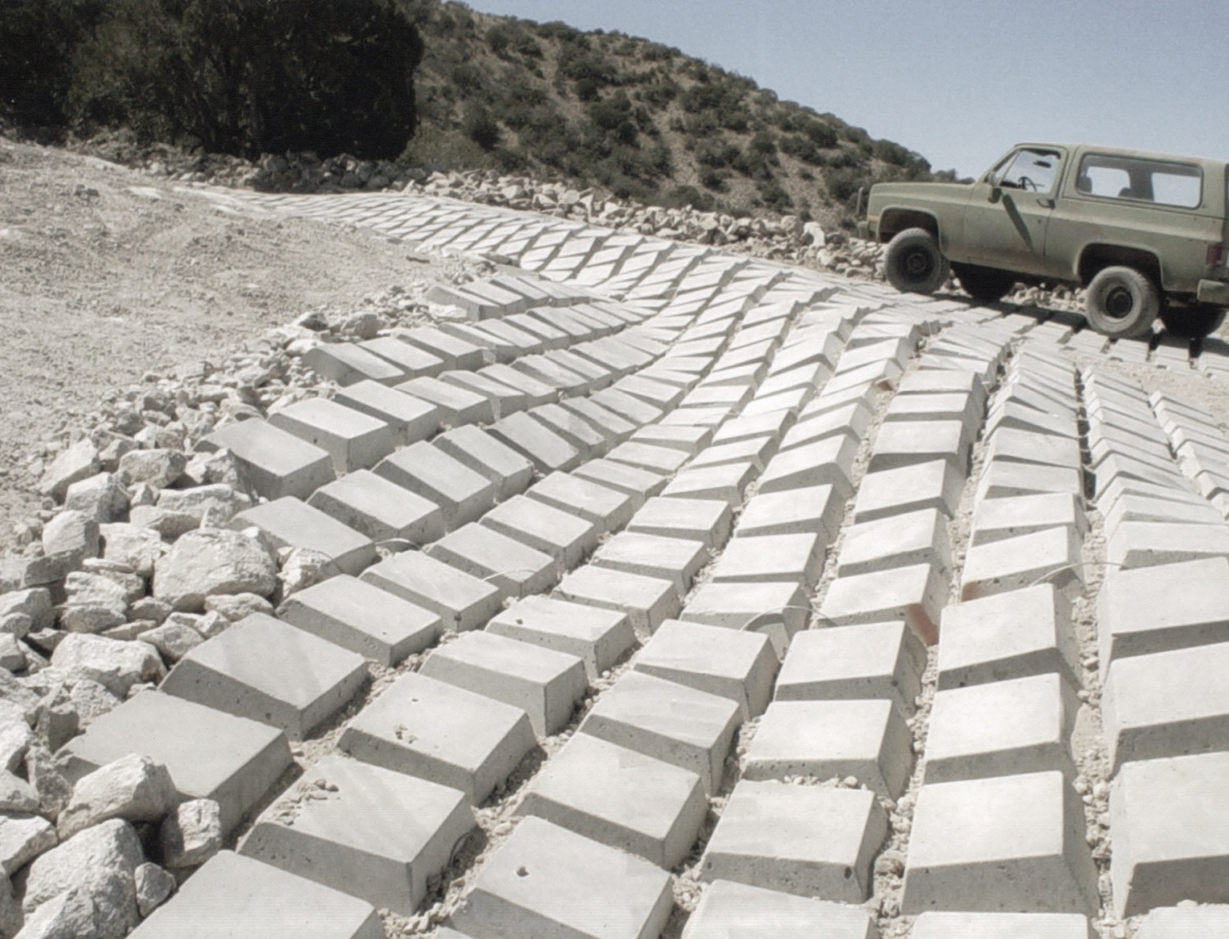

INTERNATIONAL EROSION CONTROL SYSTEMS
Manufacturing and selling soil stabilizing erosion control products since 1984.

Slide 3
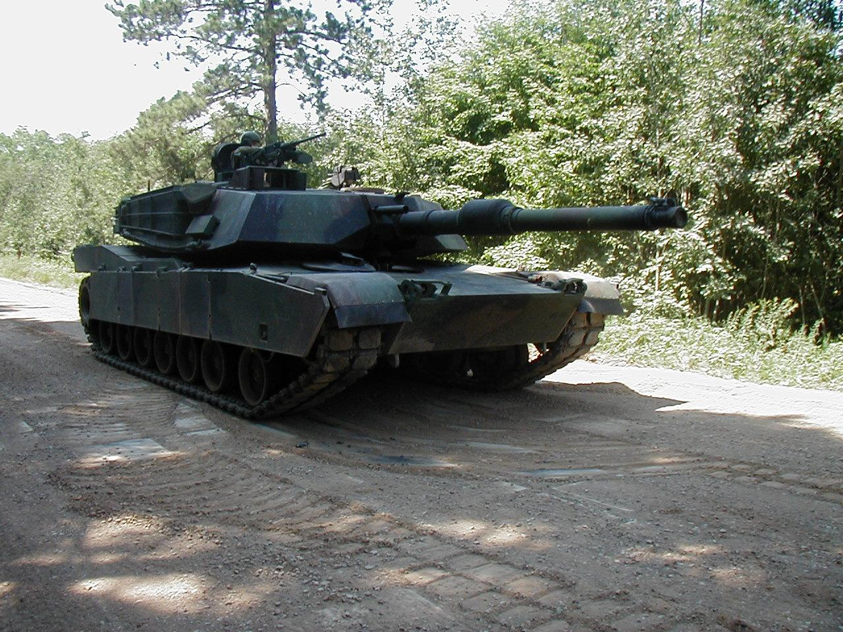
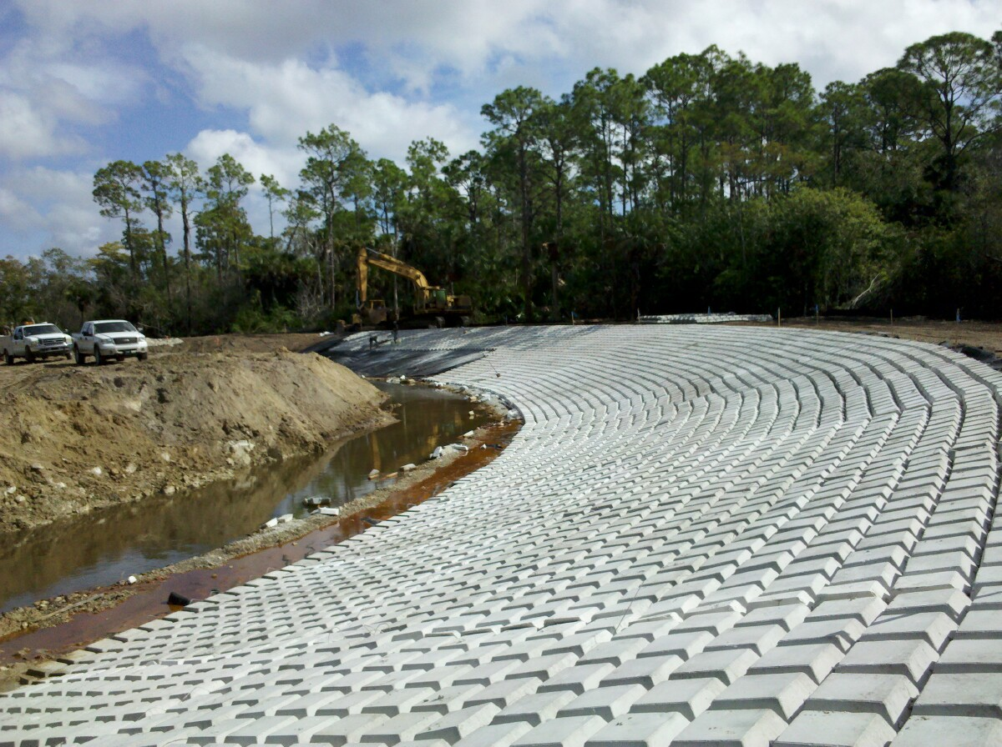
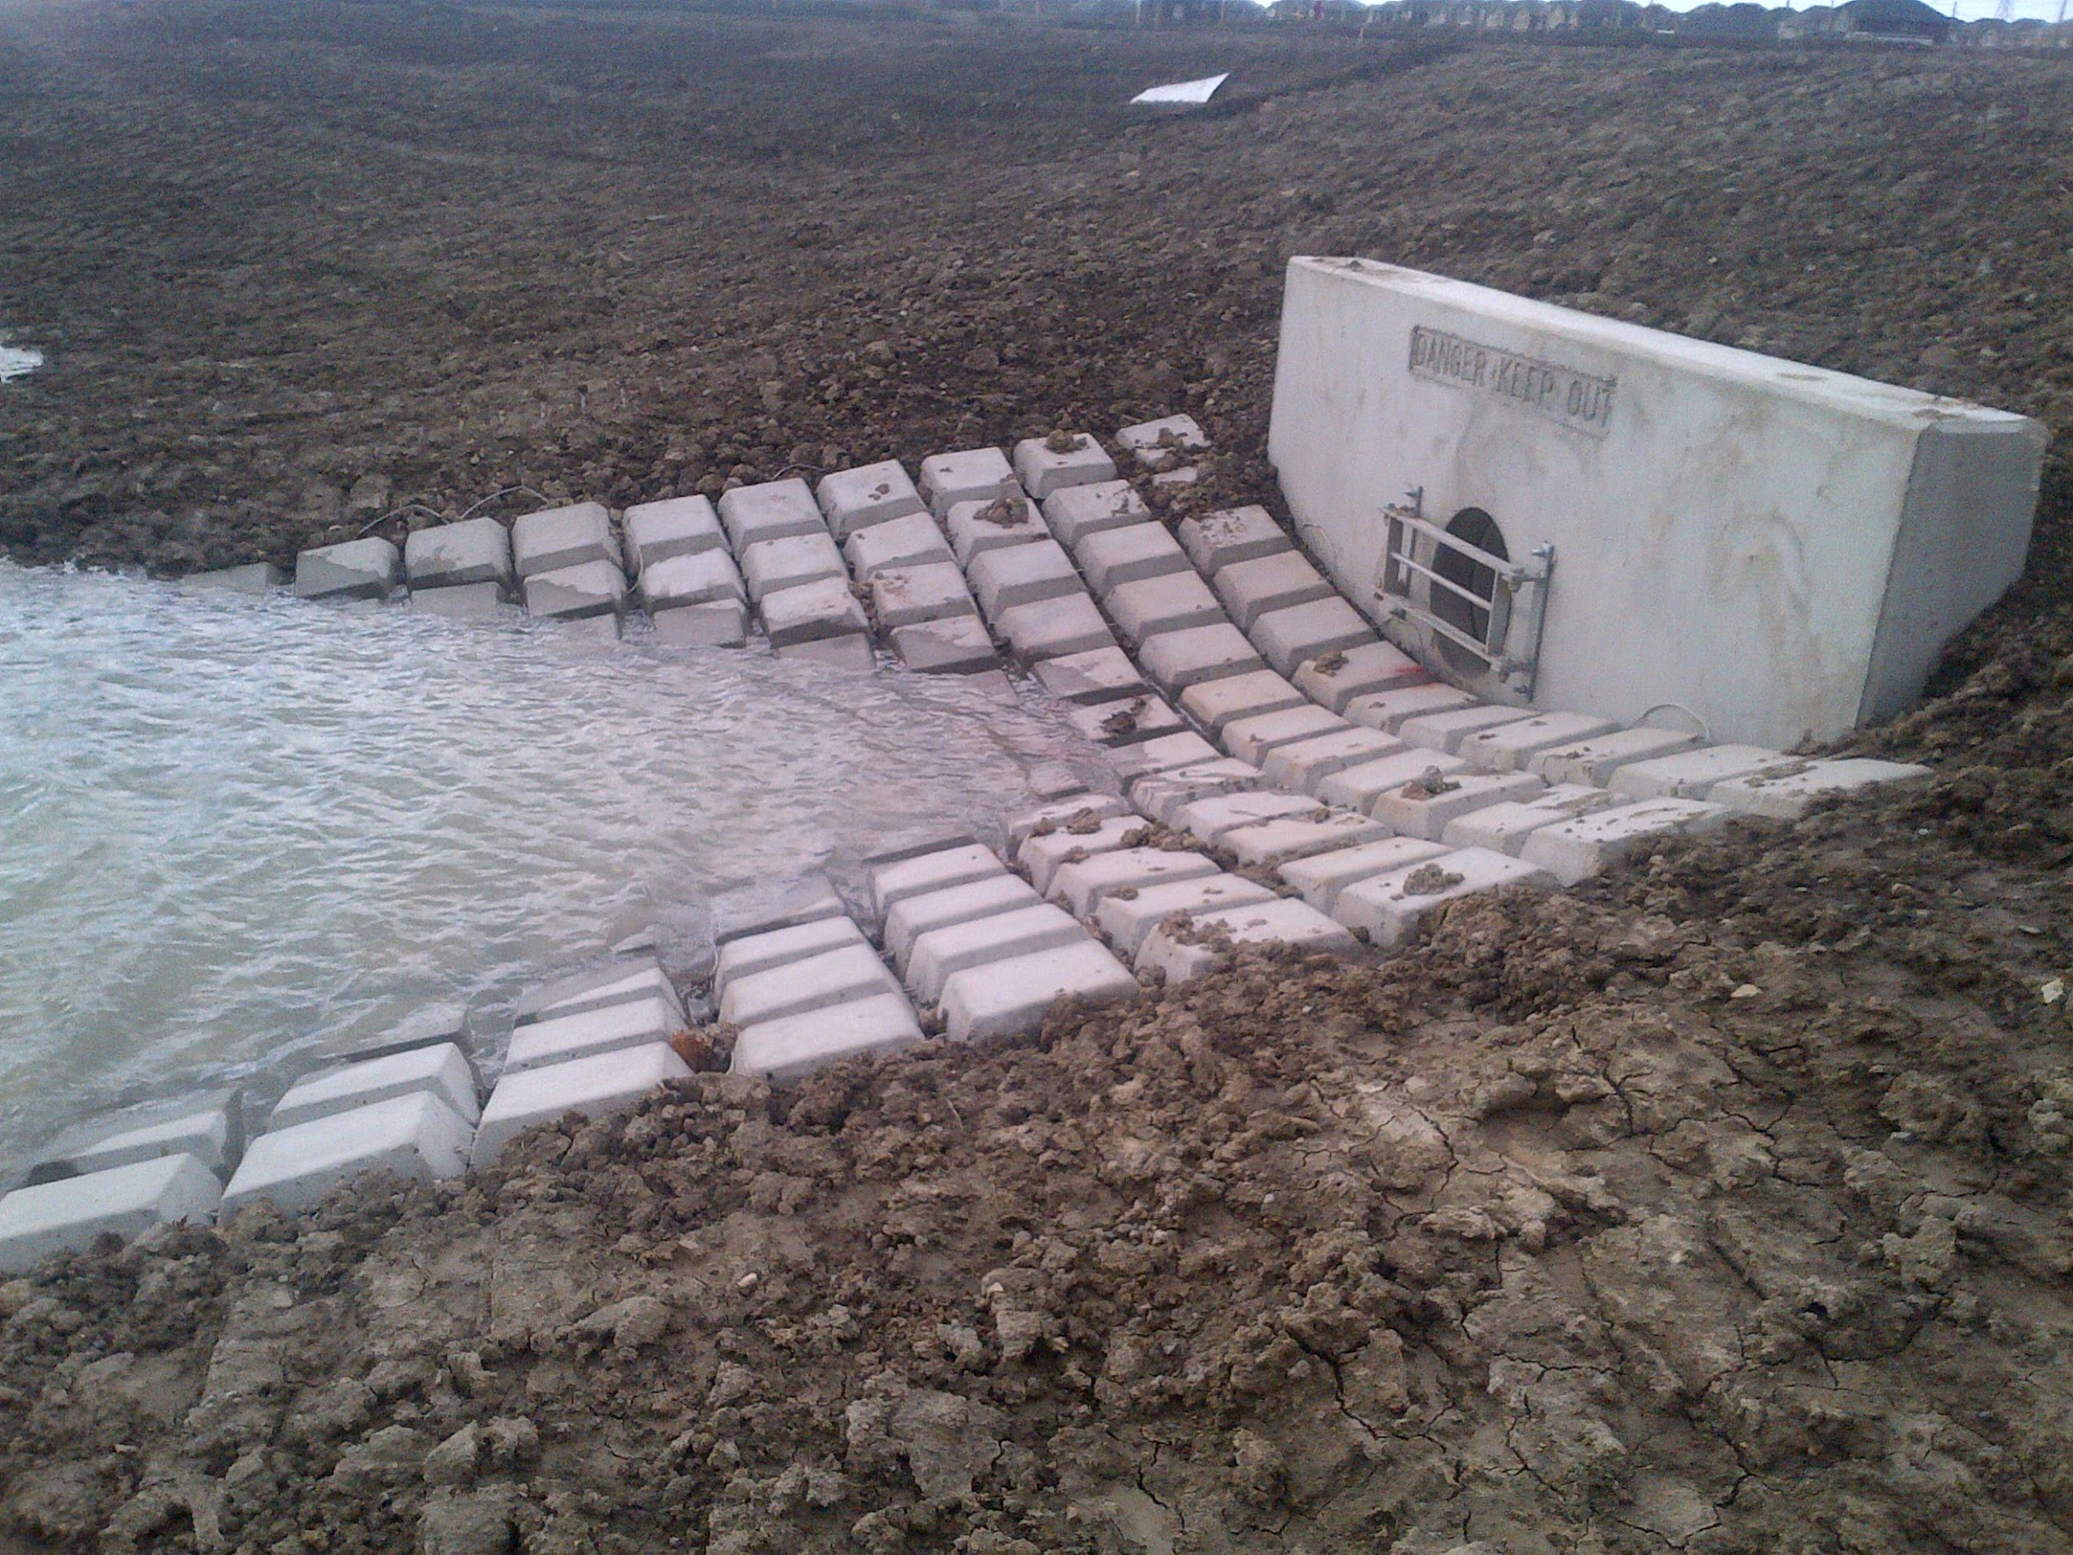
COMPANY INFORMATION
International Erosion Control Systems is a company that manufactures and sells soil stabilization erosion control products. They conduct business internationally in countries such as :
Canada
United States
Mexico
Peru
Bolivia
Nigeria
INTERNATIONAL EROSION CONTROL SYSTEMS

Slide 4
PROJECT OBJECTIVE
For this project, the client came to us with the goal of revamping an offline based tool into a more user friendly, online one that would promote sales and encourage client interaction with IECS.
For our team, that meant research and implementation time into the design and functional aspects of the tool.
INTERNATIONAL EROSION CONTROL SYSTEMS

Slide 5
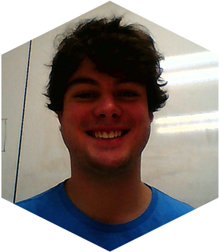
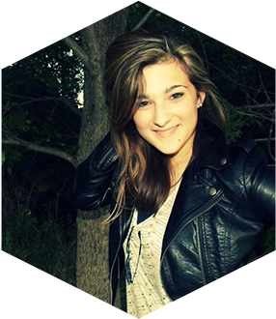
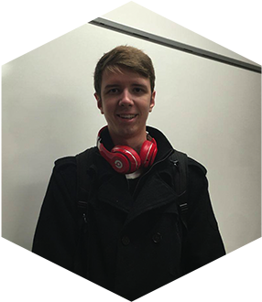
OUR TEAM
In order to work as efficiently as possible, our team is divided into three parts.
NICK IRELAND
Front-End
Web Development
SHANNON ENWRIGHT
Graphic Design
& Front-End
ADAM LUXTON
Back-End
Web Development

Slide 6
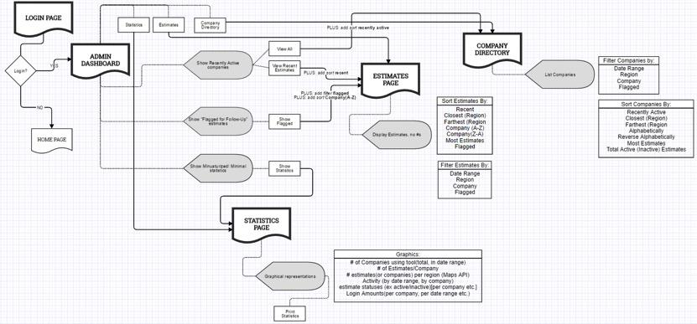
SEPTEMBER
September was Research month. Our team spent it’s infant hours researching about IECS, the various development frameworks we were going to use, and discussing user experience and user stories.
Research
Wireframes
Learning frameworks to use in the app.
OUR
TIMELINE

Slide 7
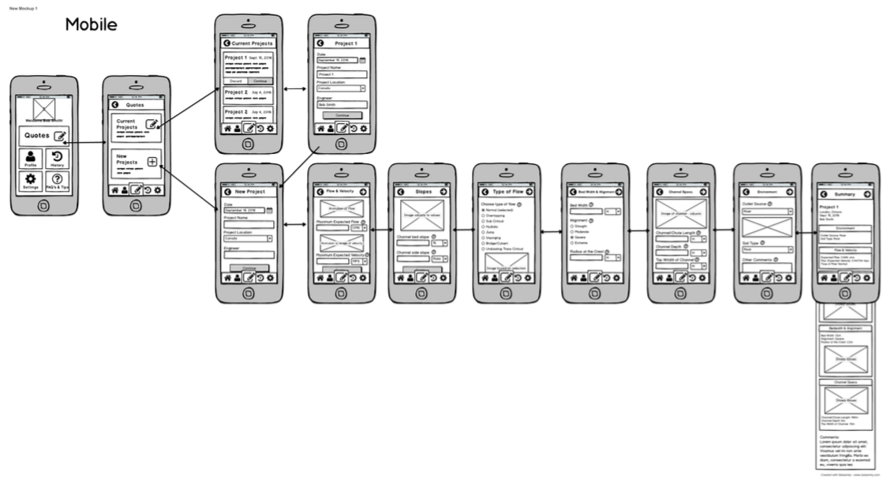
WIREFRAMES

Slide 8
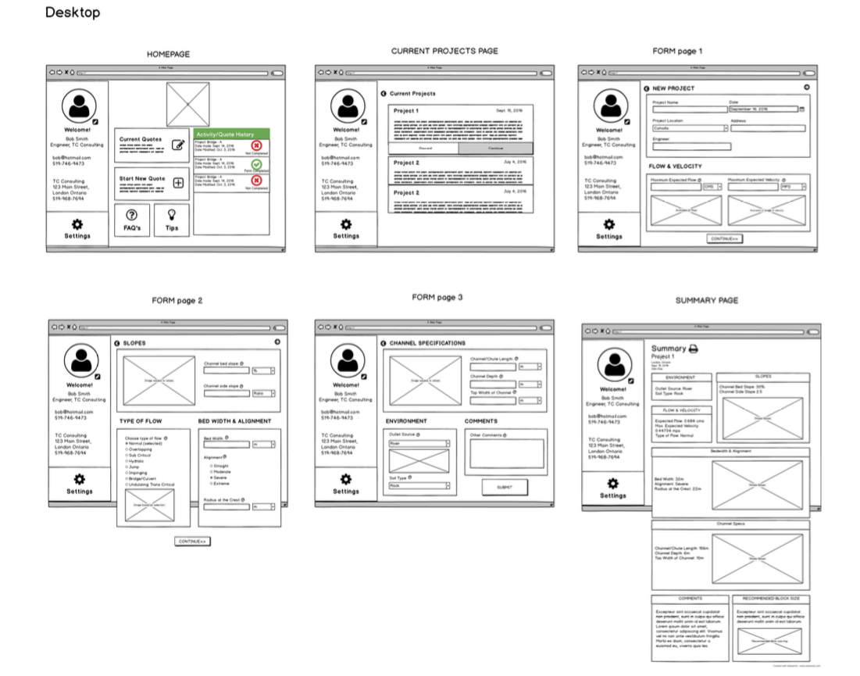
WIREFRAMES

Slide 9
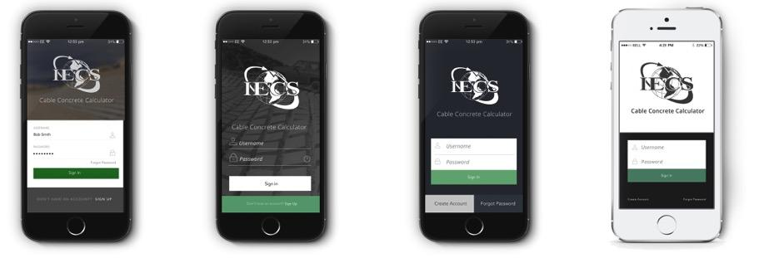
OCTOBER
This month, we started kicking off the development phase.
DESIGN:
Start mockups
Chose overall design
Began design for mobile and desktop versions
FRONT-END:
Start coding
BACK-END:
Writing the database and preparing the queries to utilize it. Begin to prepare the MVC system that will dictate page-content.
OUR
TIMELINE

Slide 10
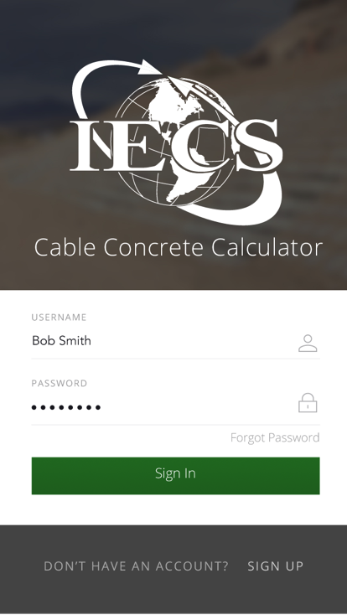
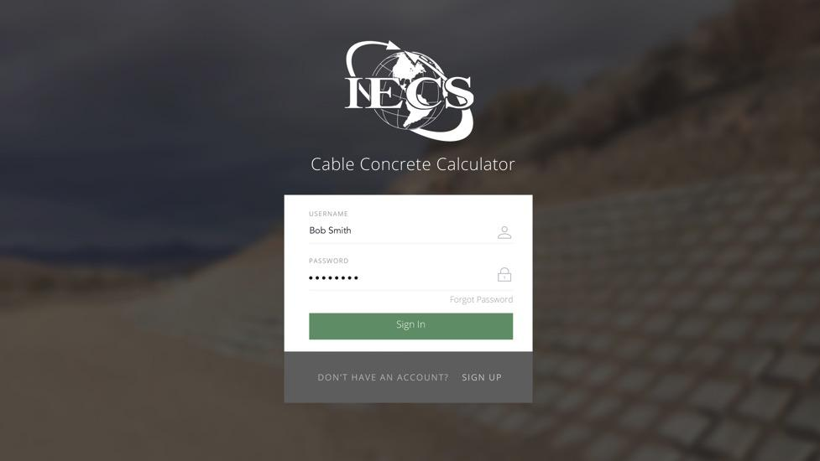
MOCKUPS
VERSION 1.0

Slide 11
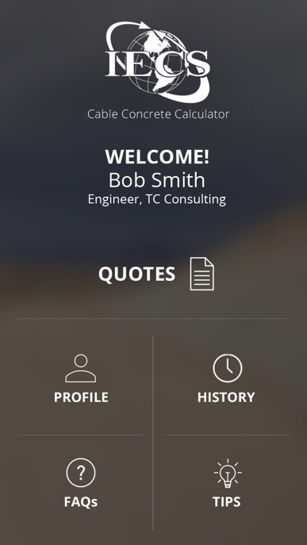
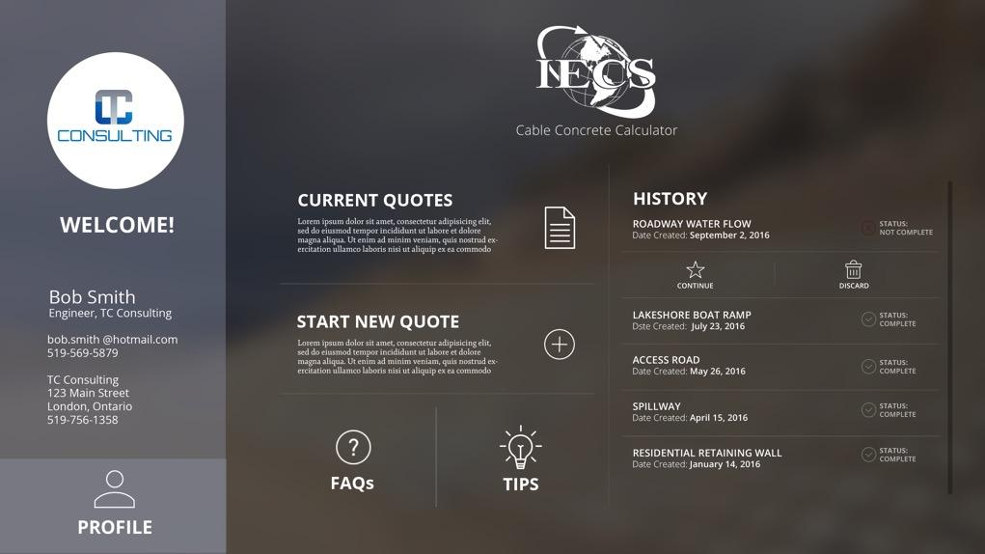
MOCKUPS

Slide 12
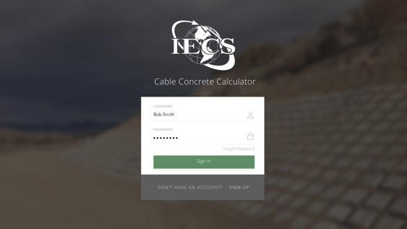
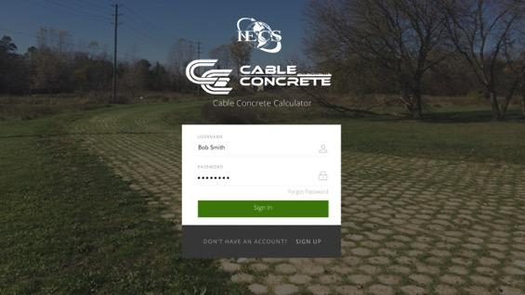

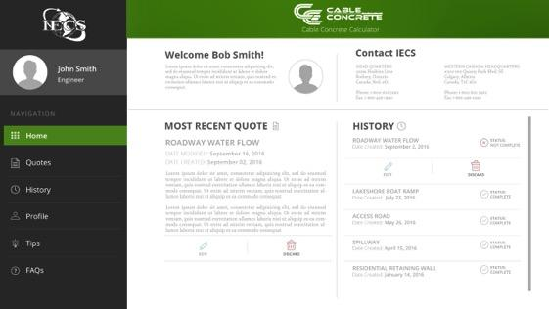
CLIENT MEETING
Client feedback
Layout and design edited based on feedback
VERSION 1.0
VERSION 2.0

Slide 13
NOVEMBER
As November ran it’s course, the application base grew and developed closer to the final project.
DESIGN:
Finish editing application design.
Beginning CMS design & layout
FRONT-END:
Continue coding, adding functionality, implementing designs
BACK-END:
Building the back-end through an MVC framework to house the application and hooking up Nick’s front-end to the backend.
OUR
TIMELINE

Slide 14
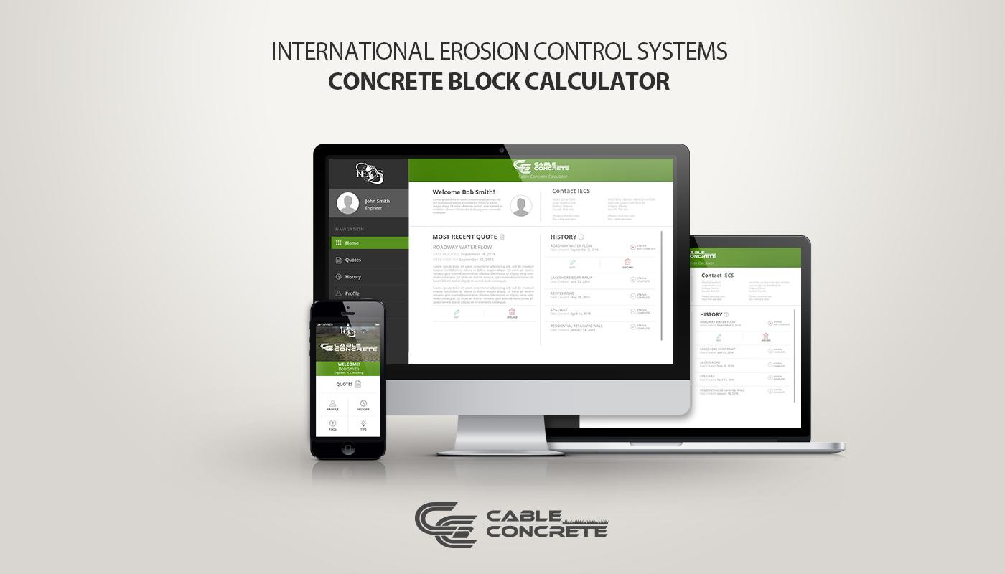
MOCKUPS

Slide 15

APP WALKTHROUGH

Slide 16


Slide 17
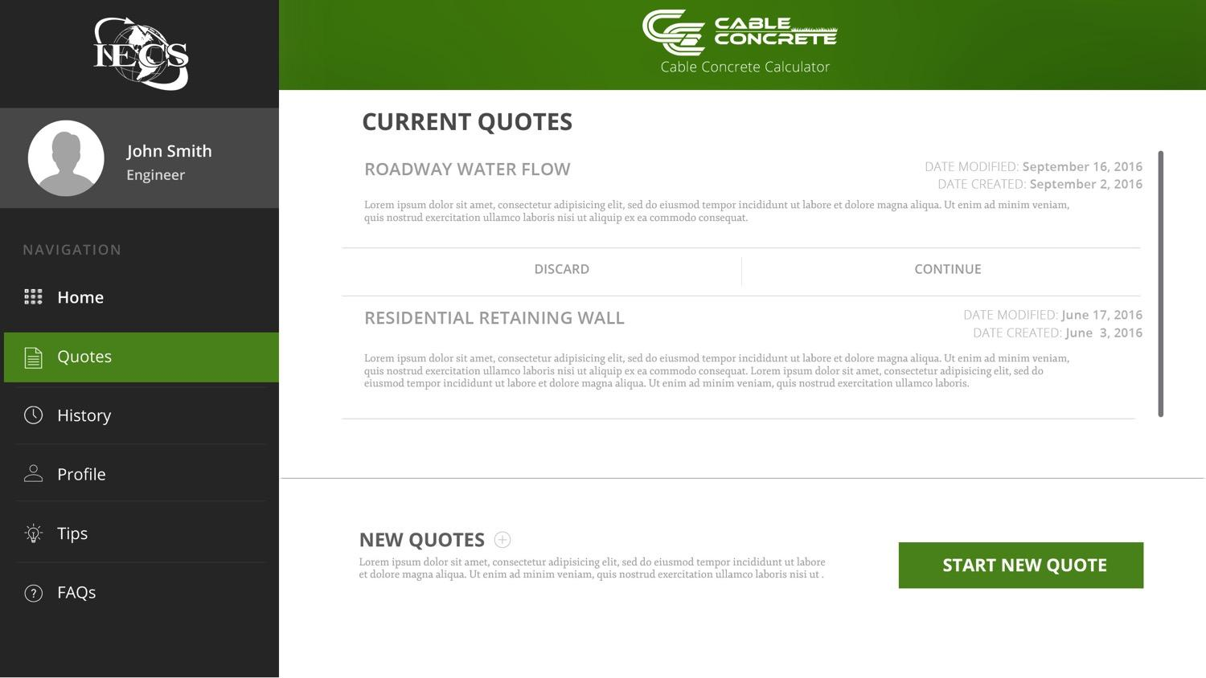

Slide 18
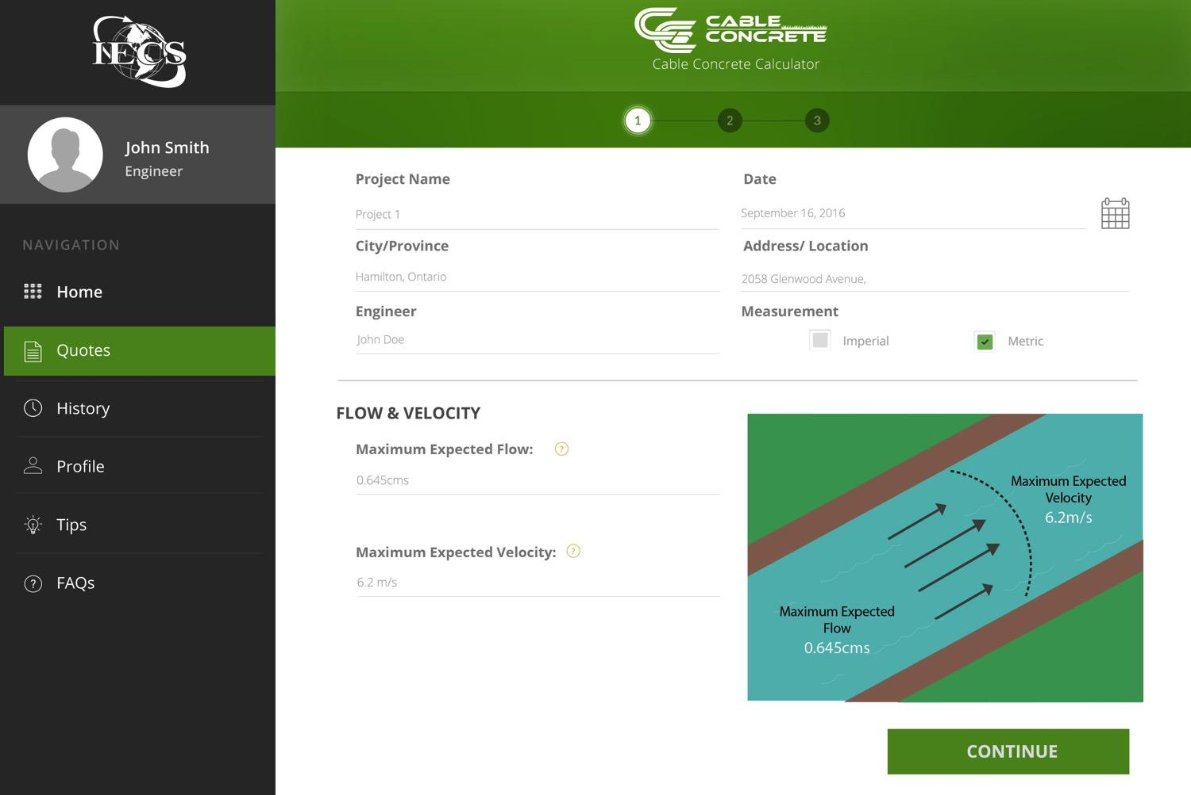

Slide 19
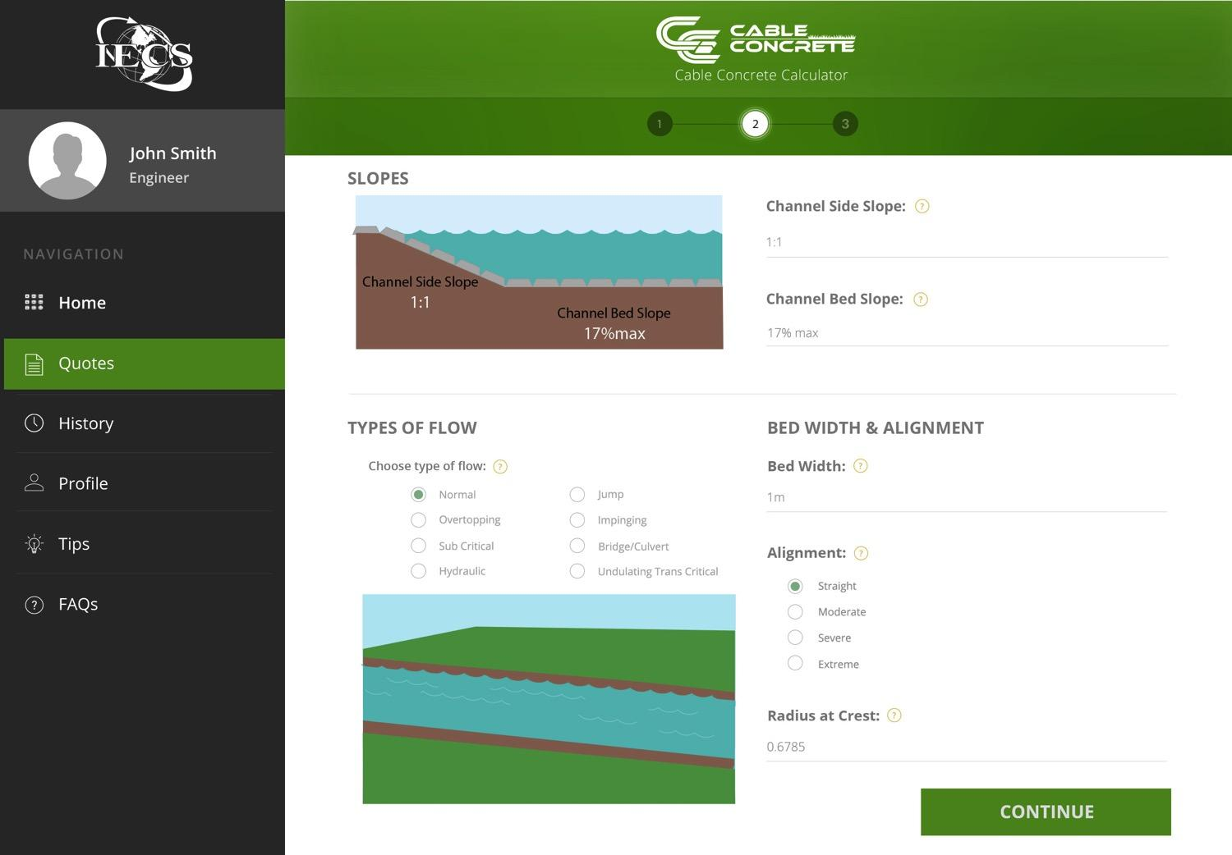

Slide 20
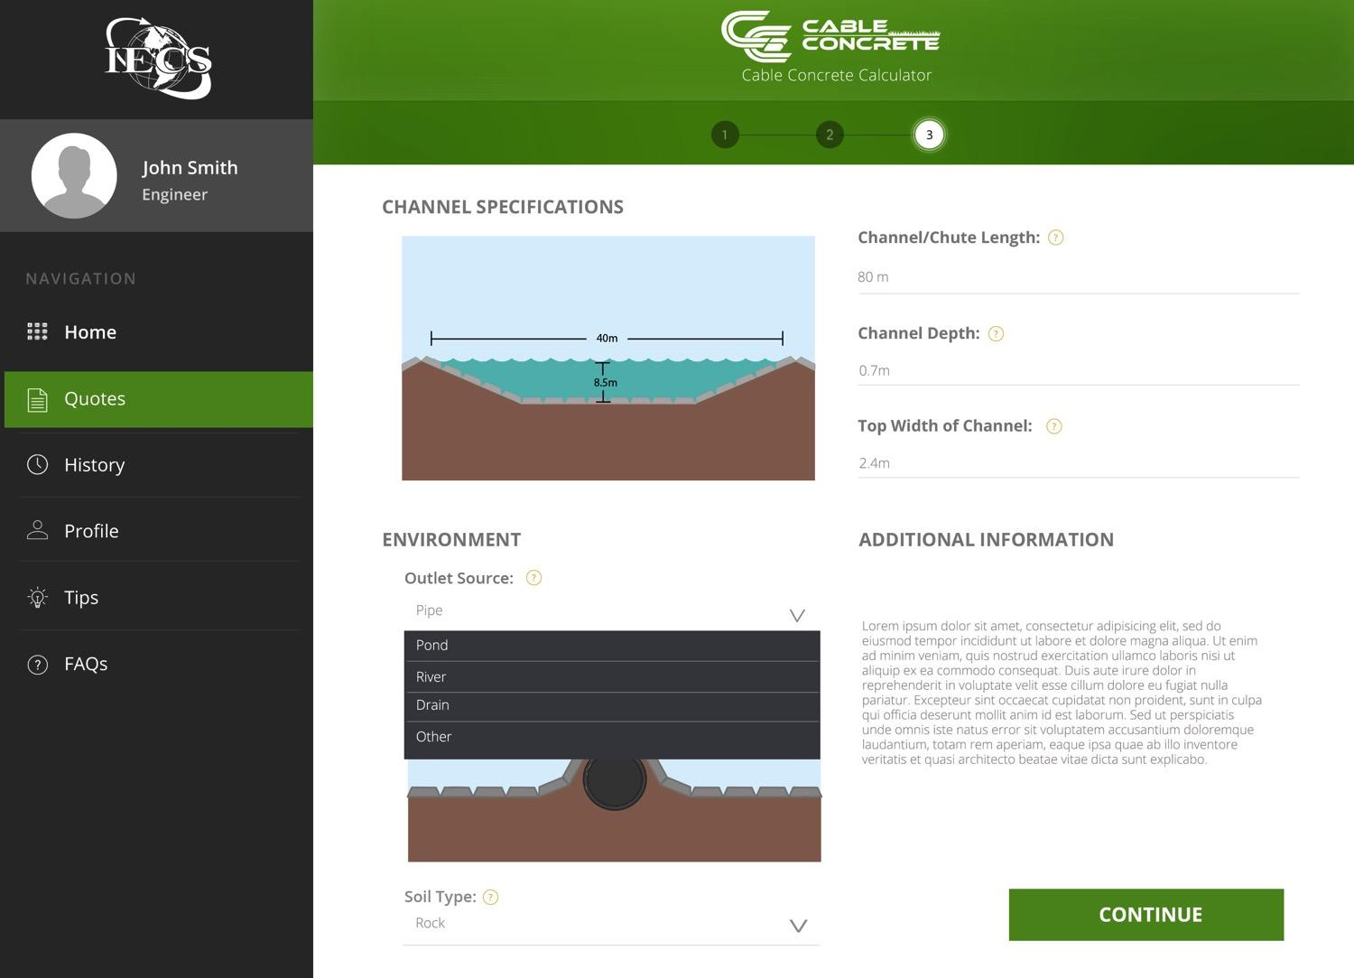

Slide 21
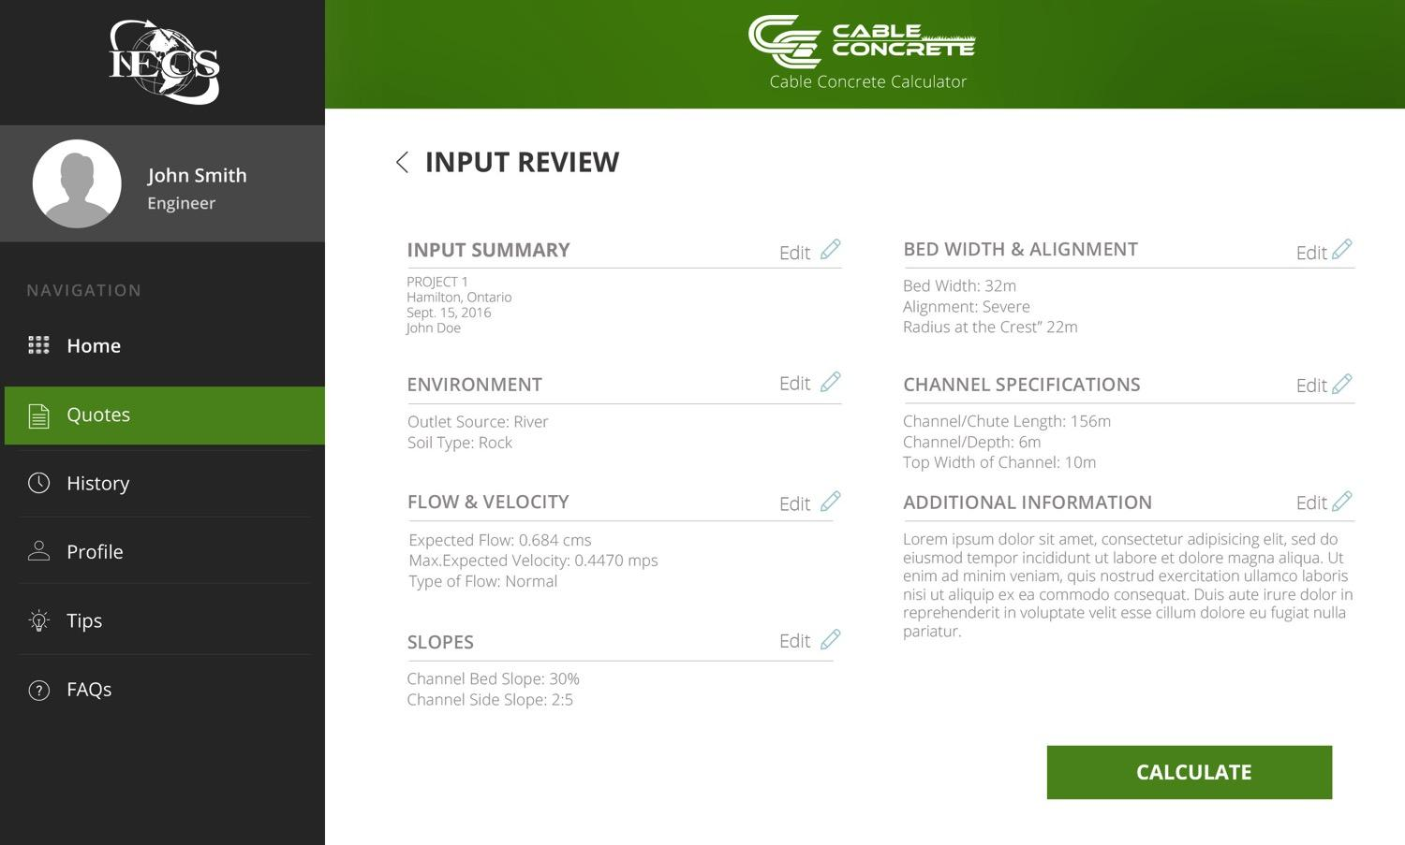

Slide 22
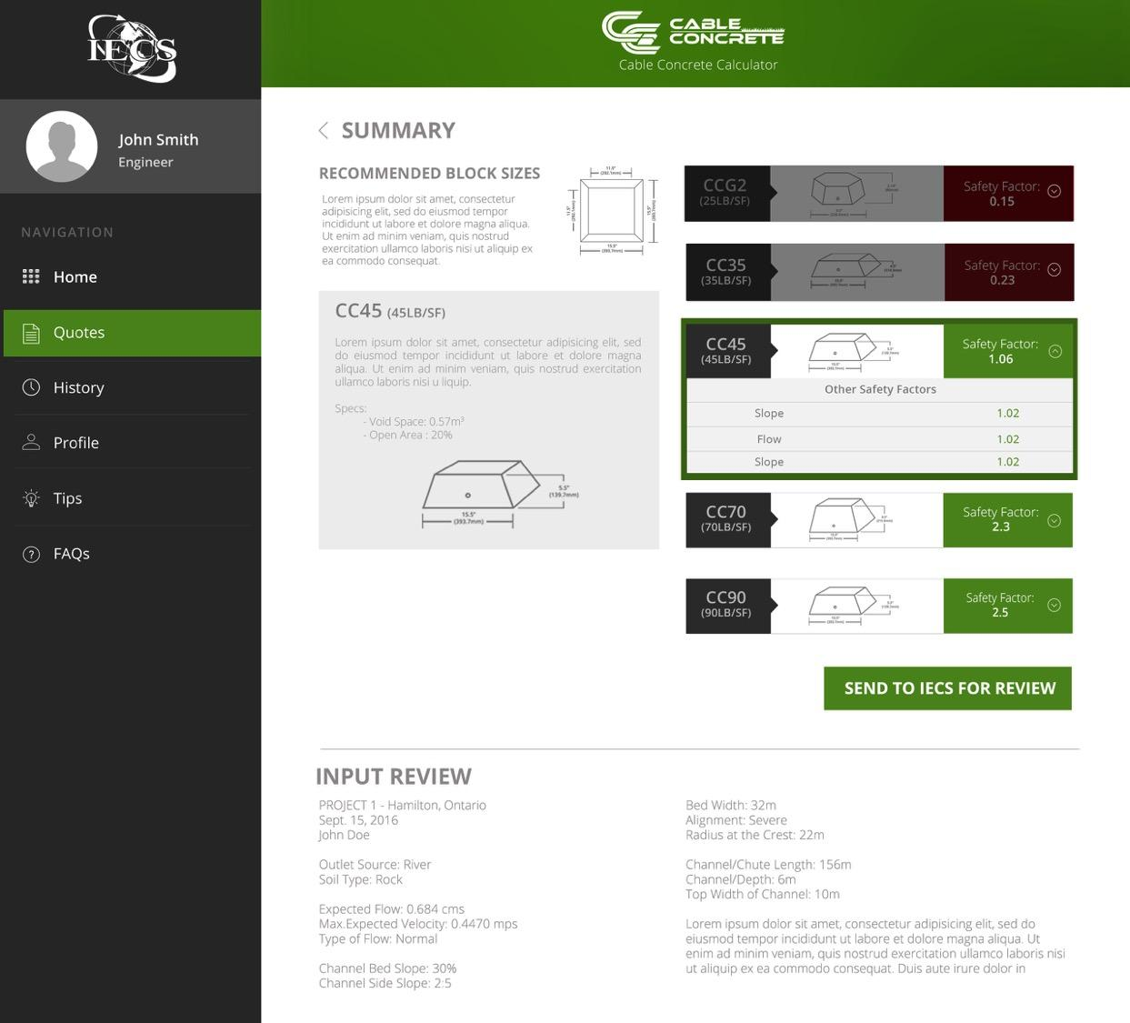

Slide 23
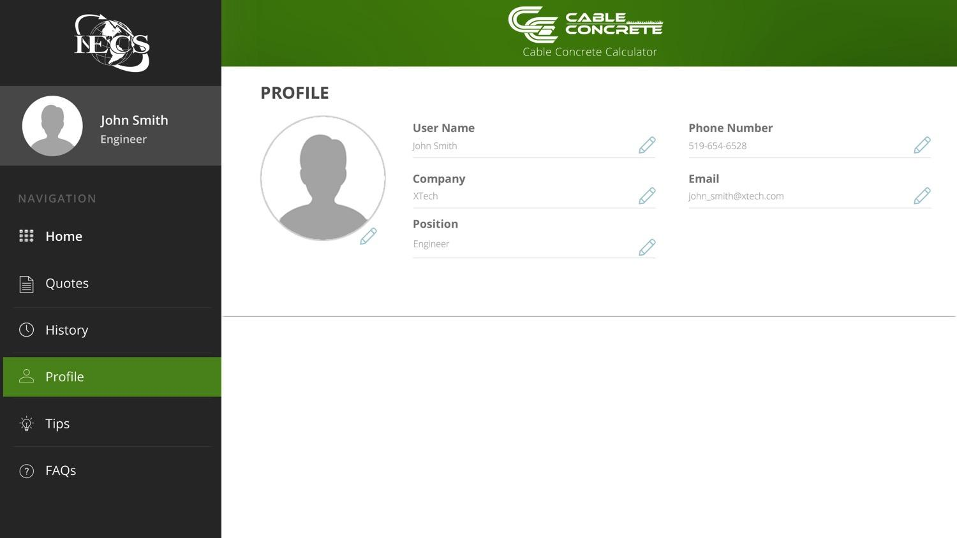

Slide 24
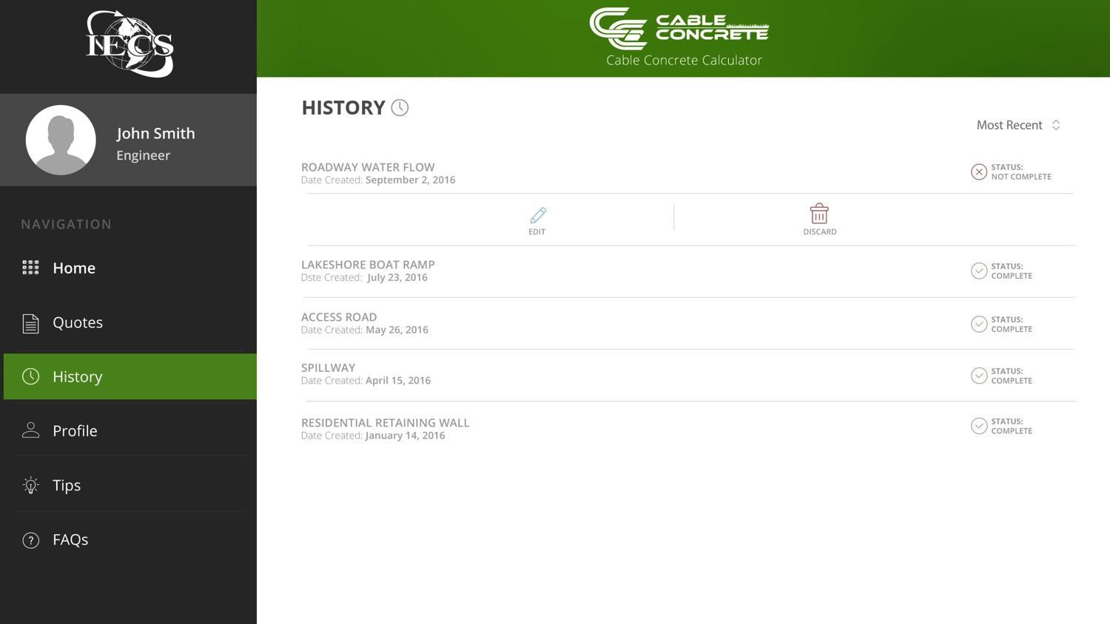

Slide 25
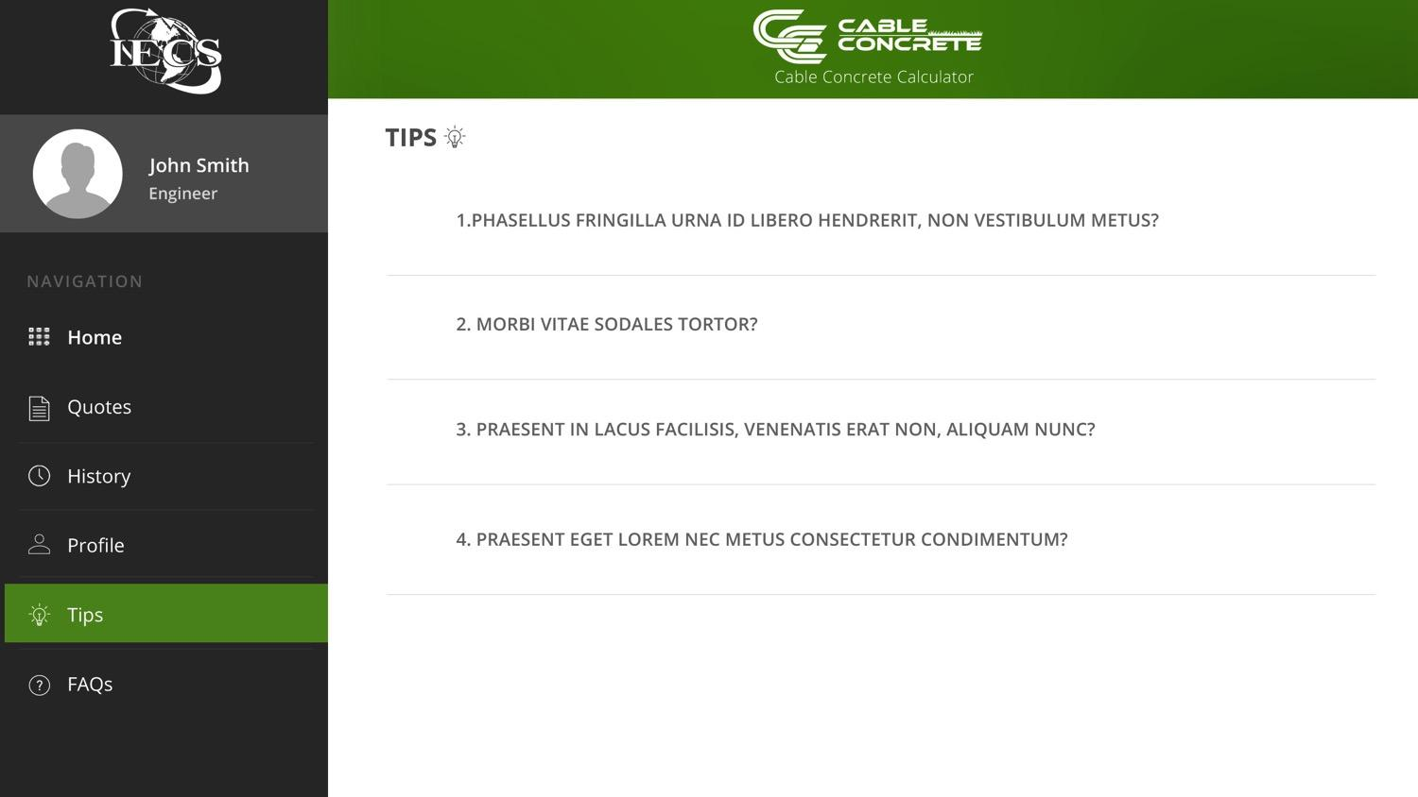

Slide 26
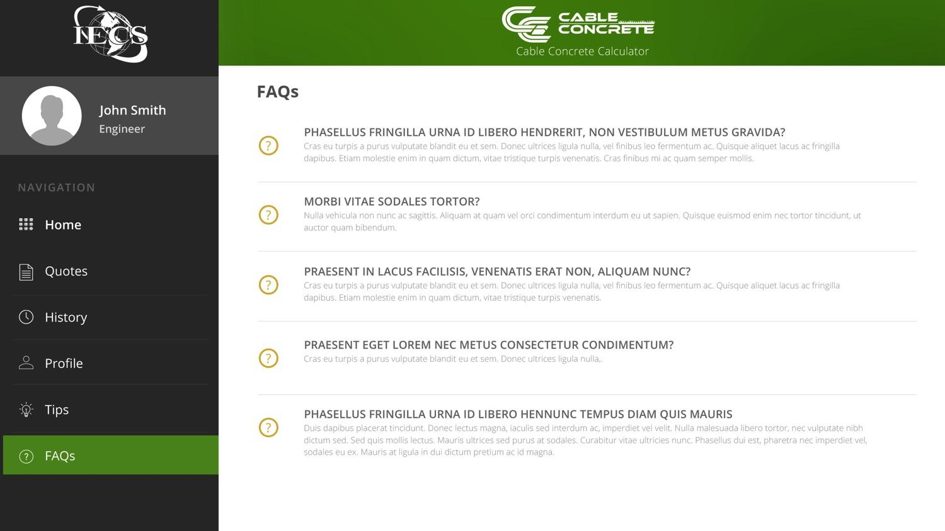

Slide 27
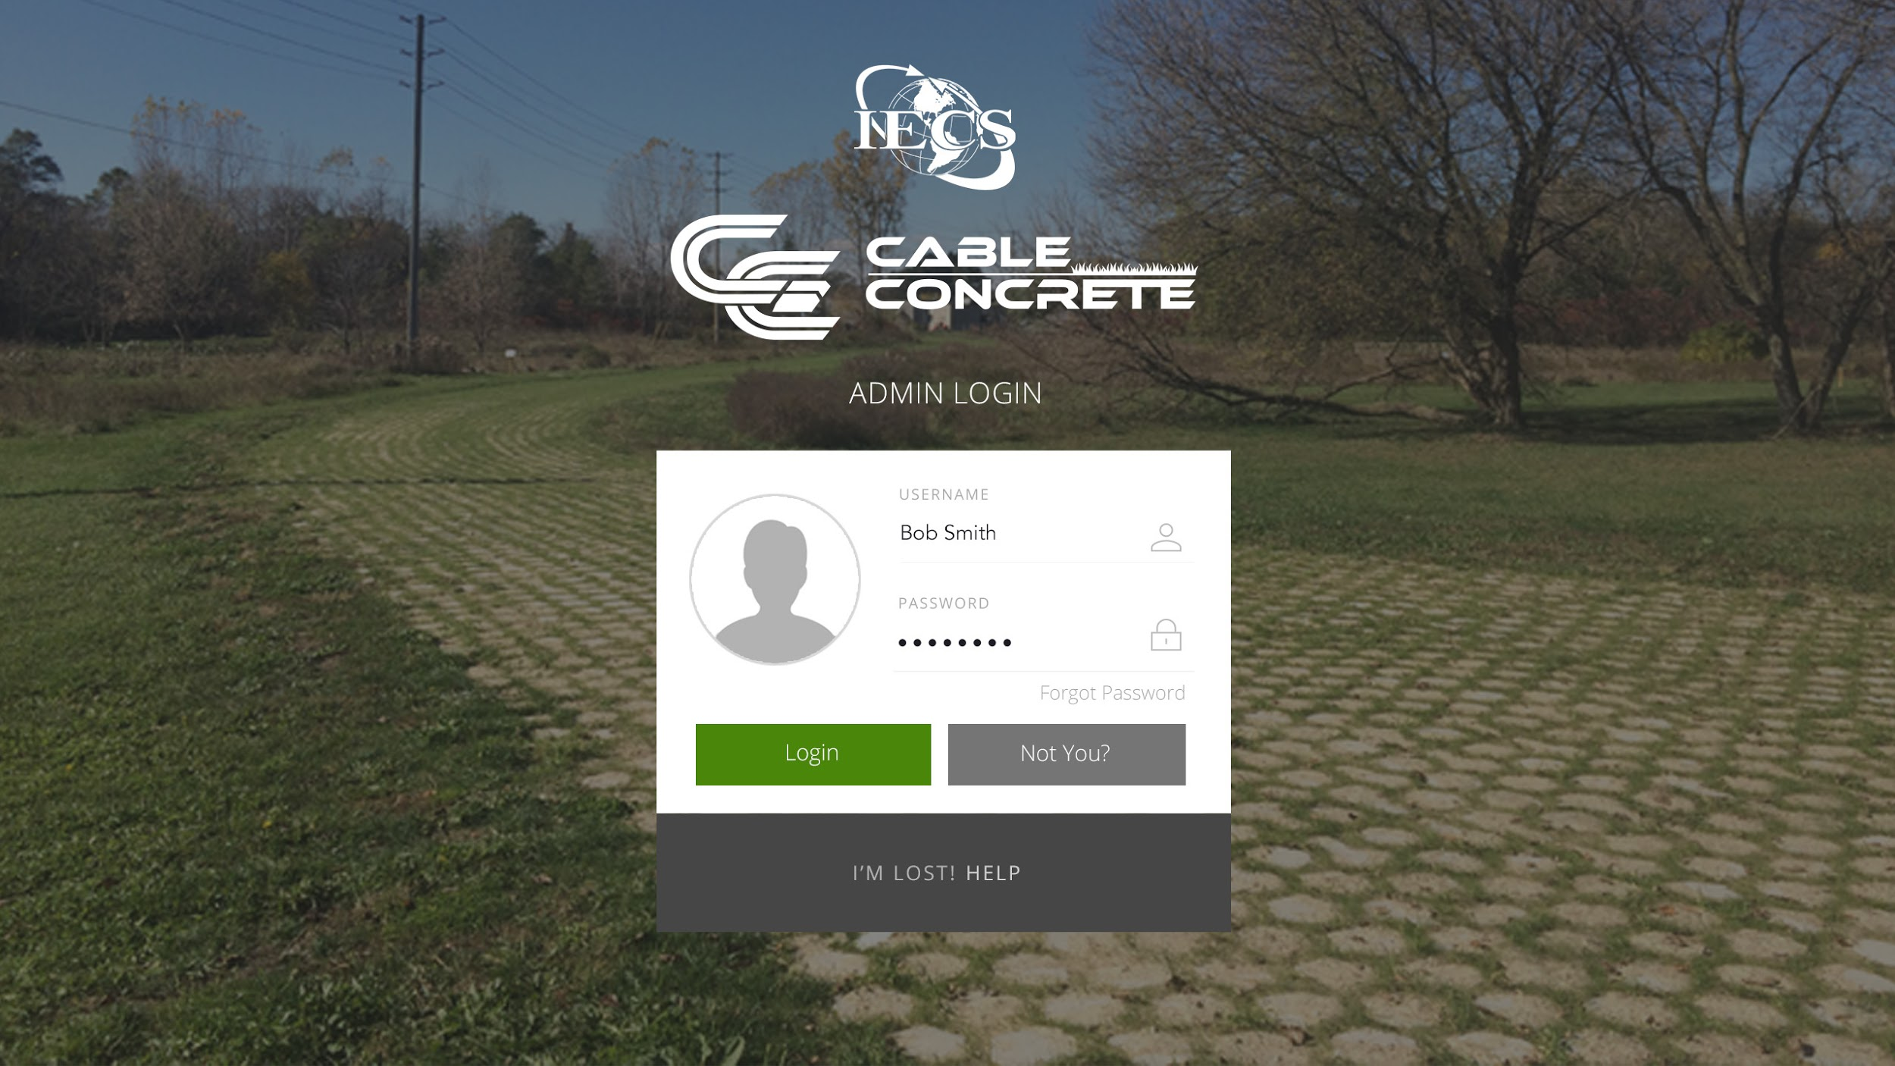
CONTENT MANAGMENT SYSTEM

Slide 28
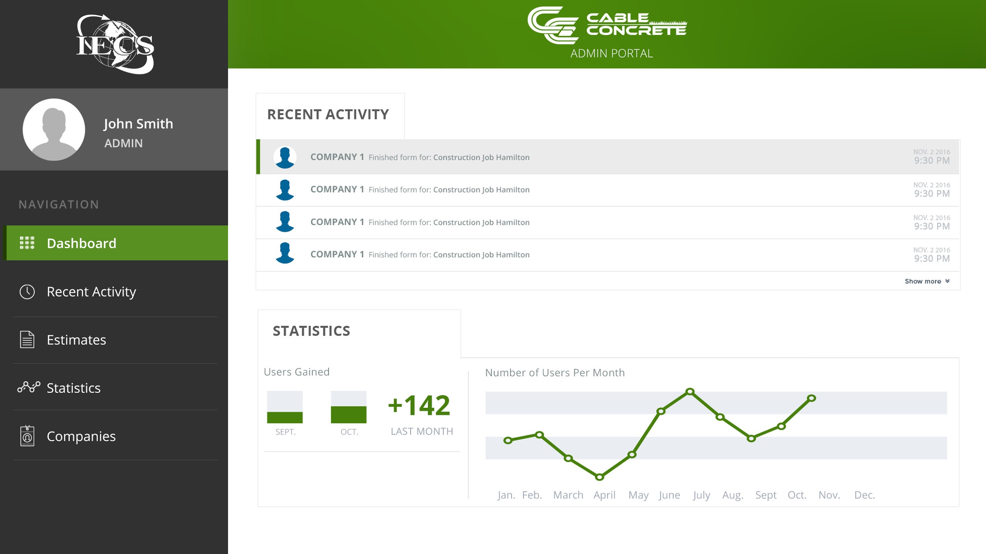
CONTENT MANAGMENT SYSTEM

Slide 29
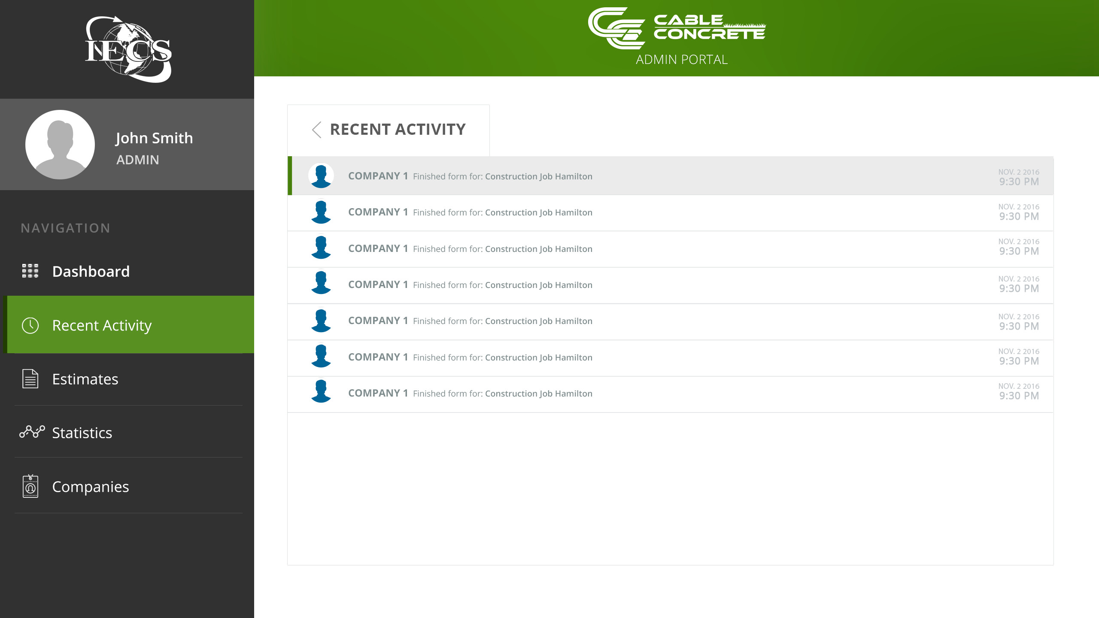
CONTENT MANAGMENT SYSTEM

Slide 30
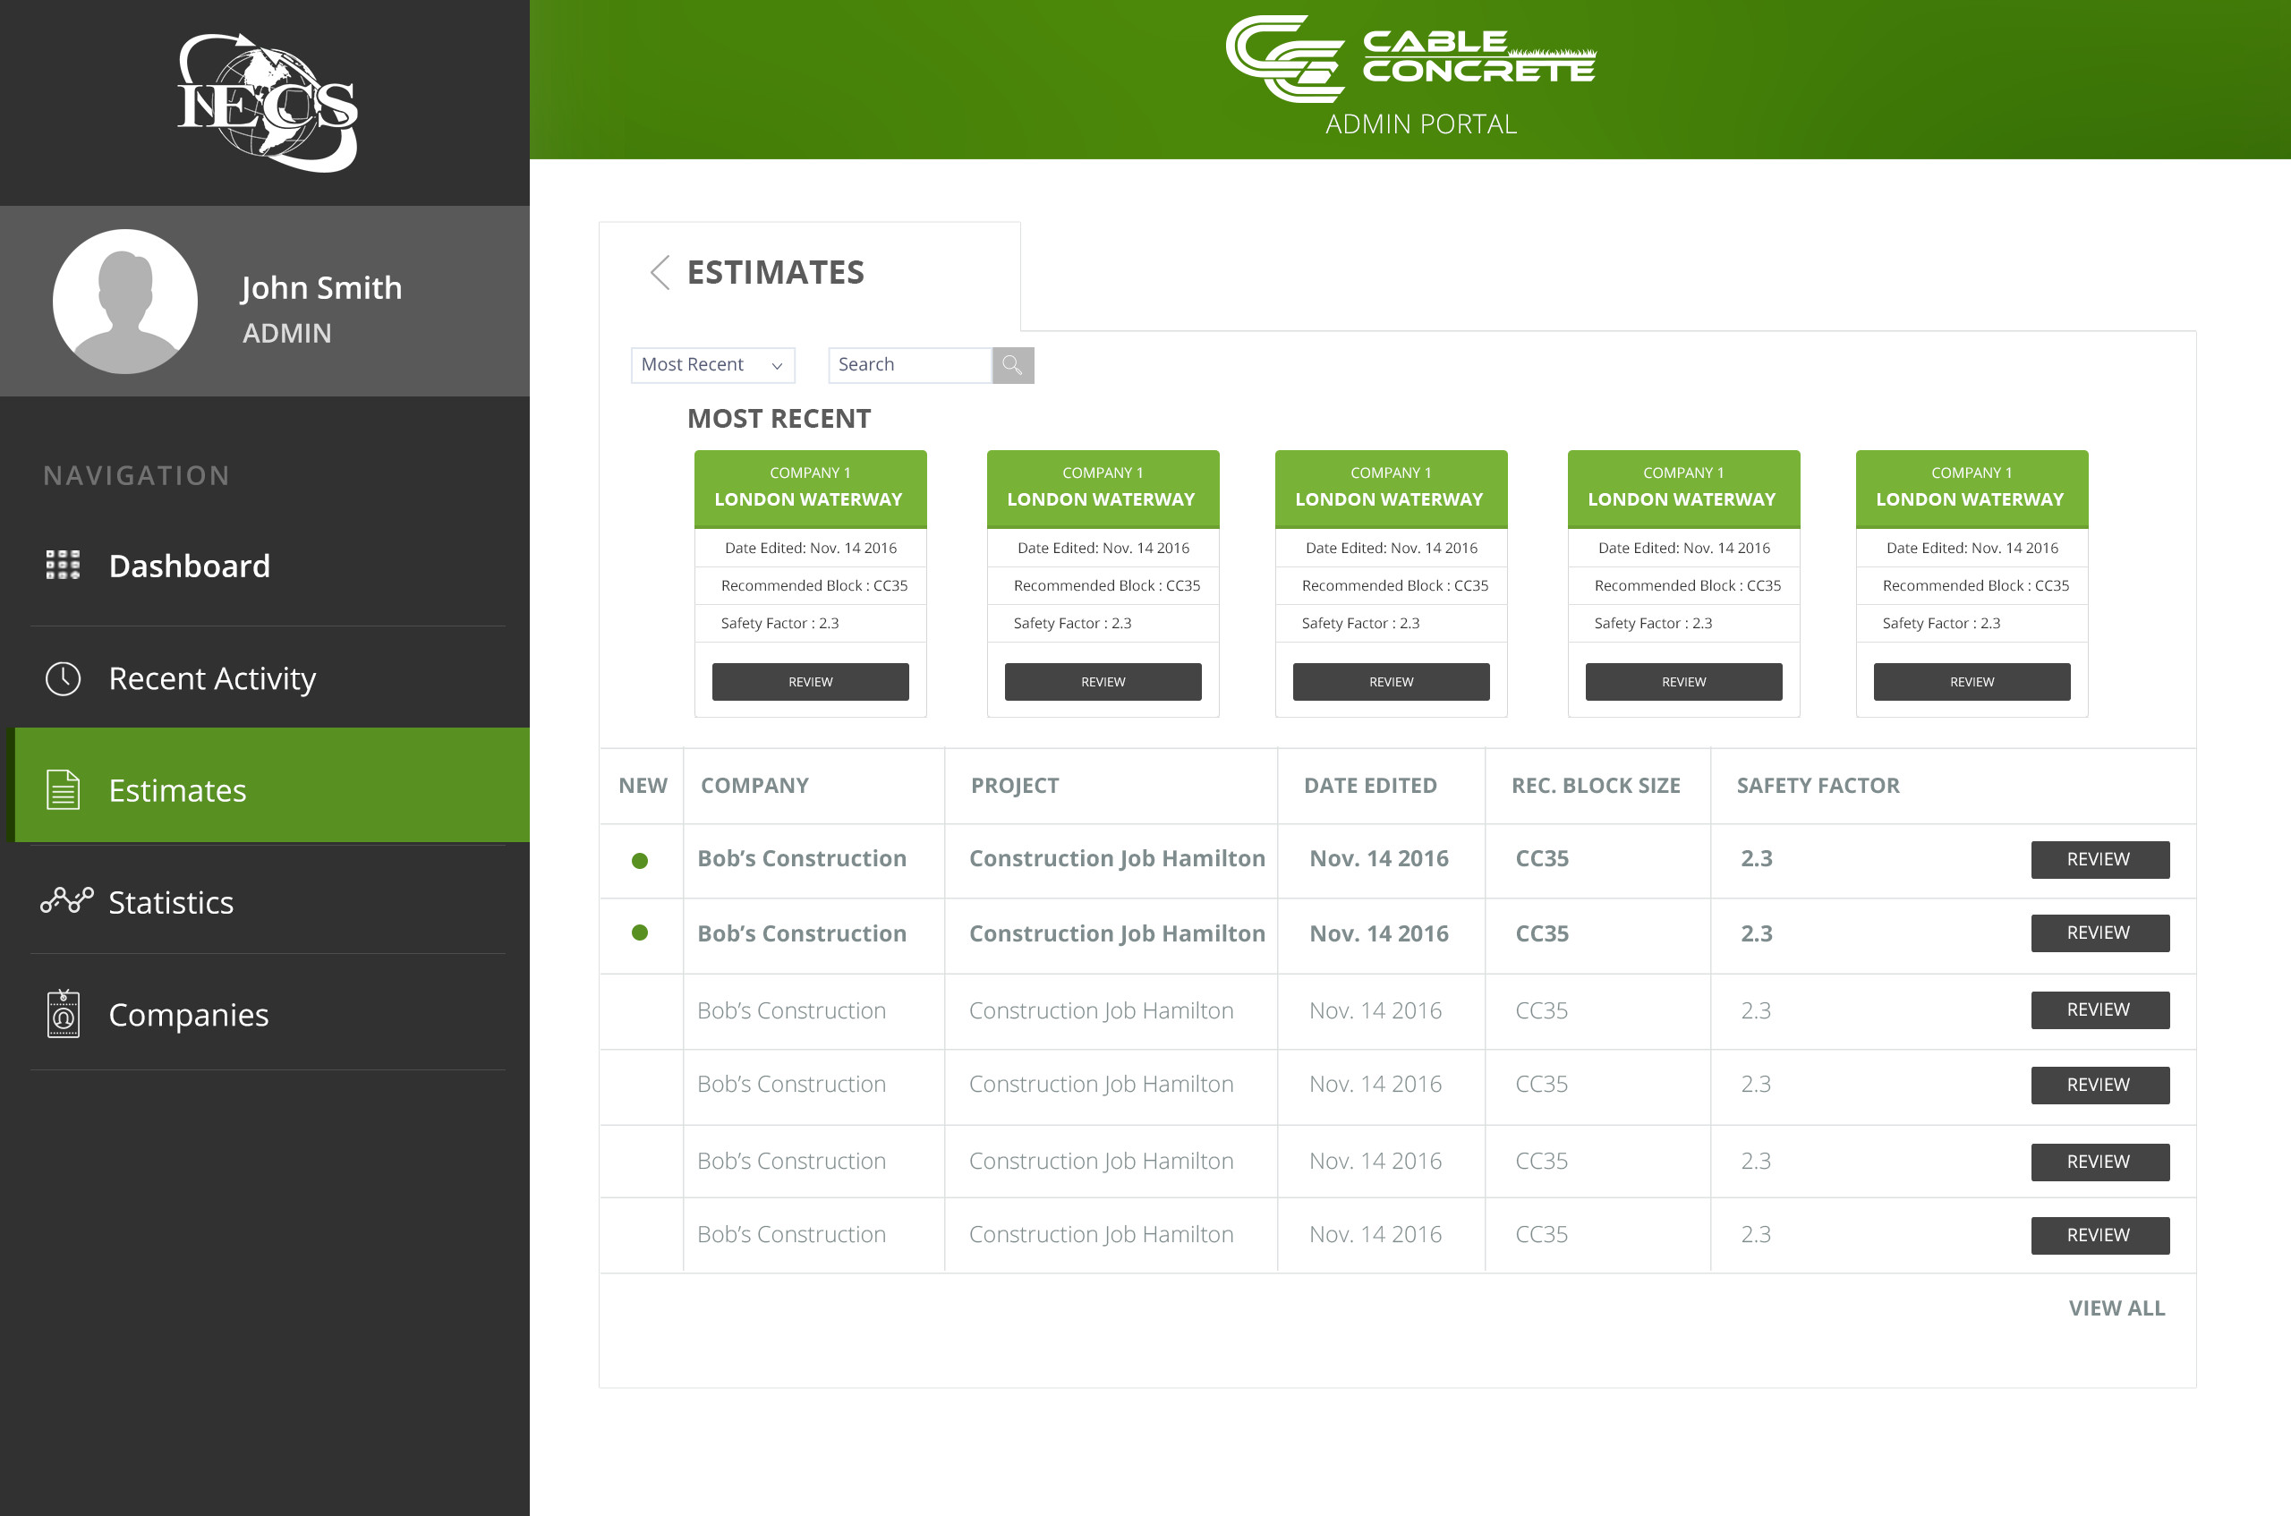
CONTENT MANAGMENT SYSTEM

Slide 31
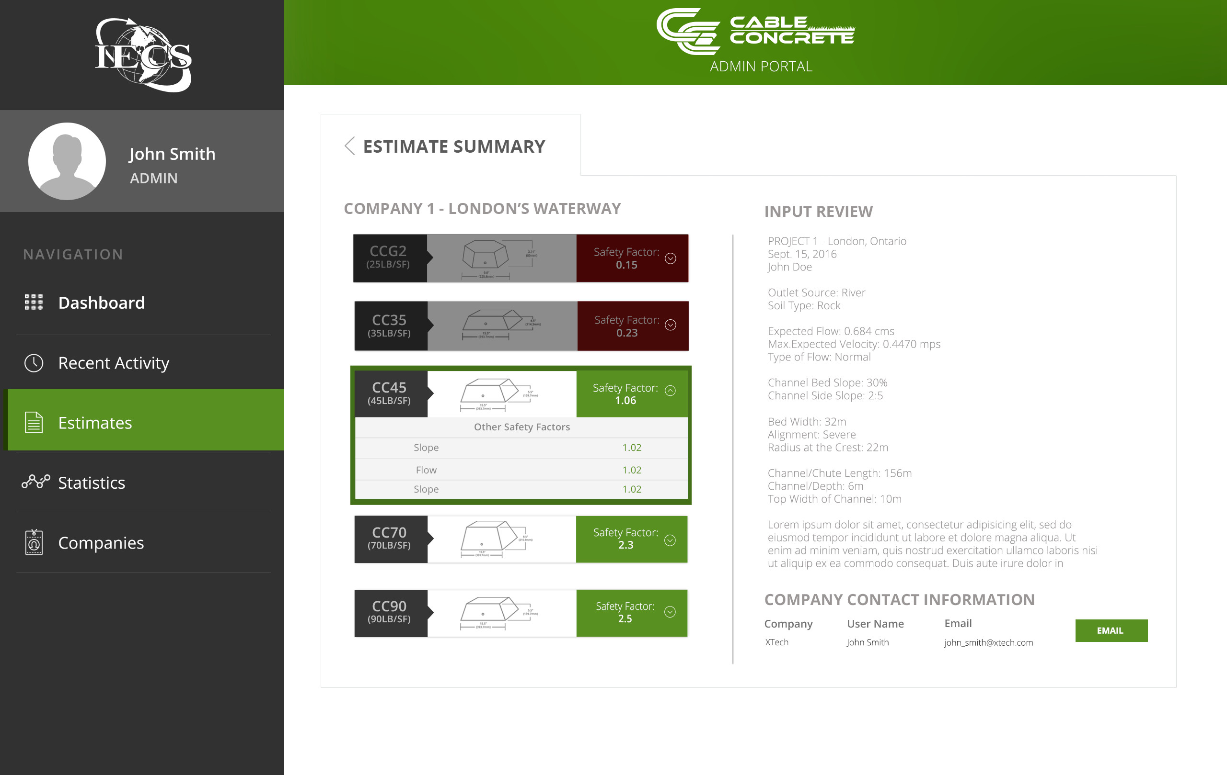
CONTENT MANAGMENT SYSTEM

Slide 32
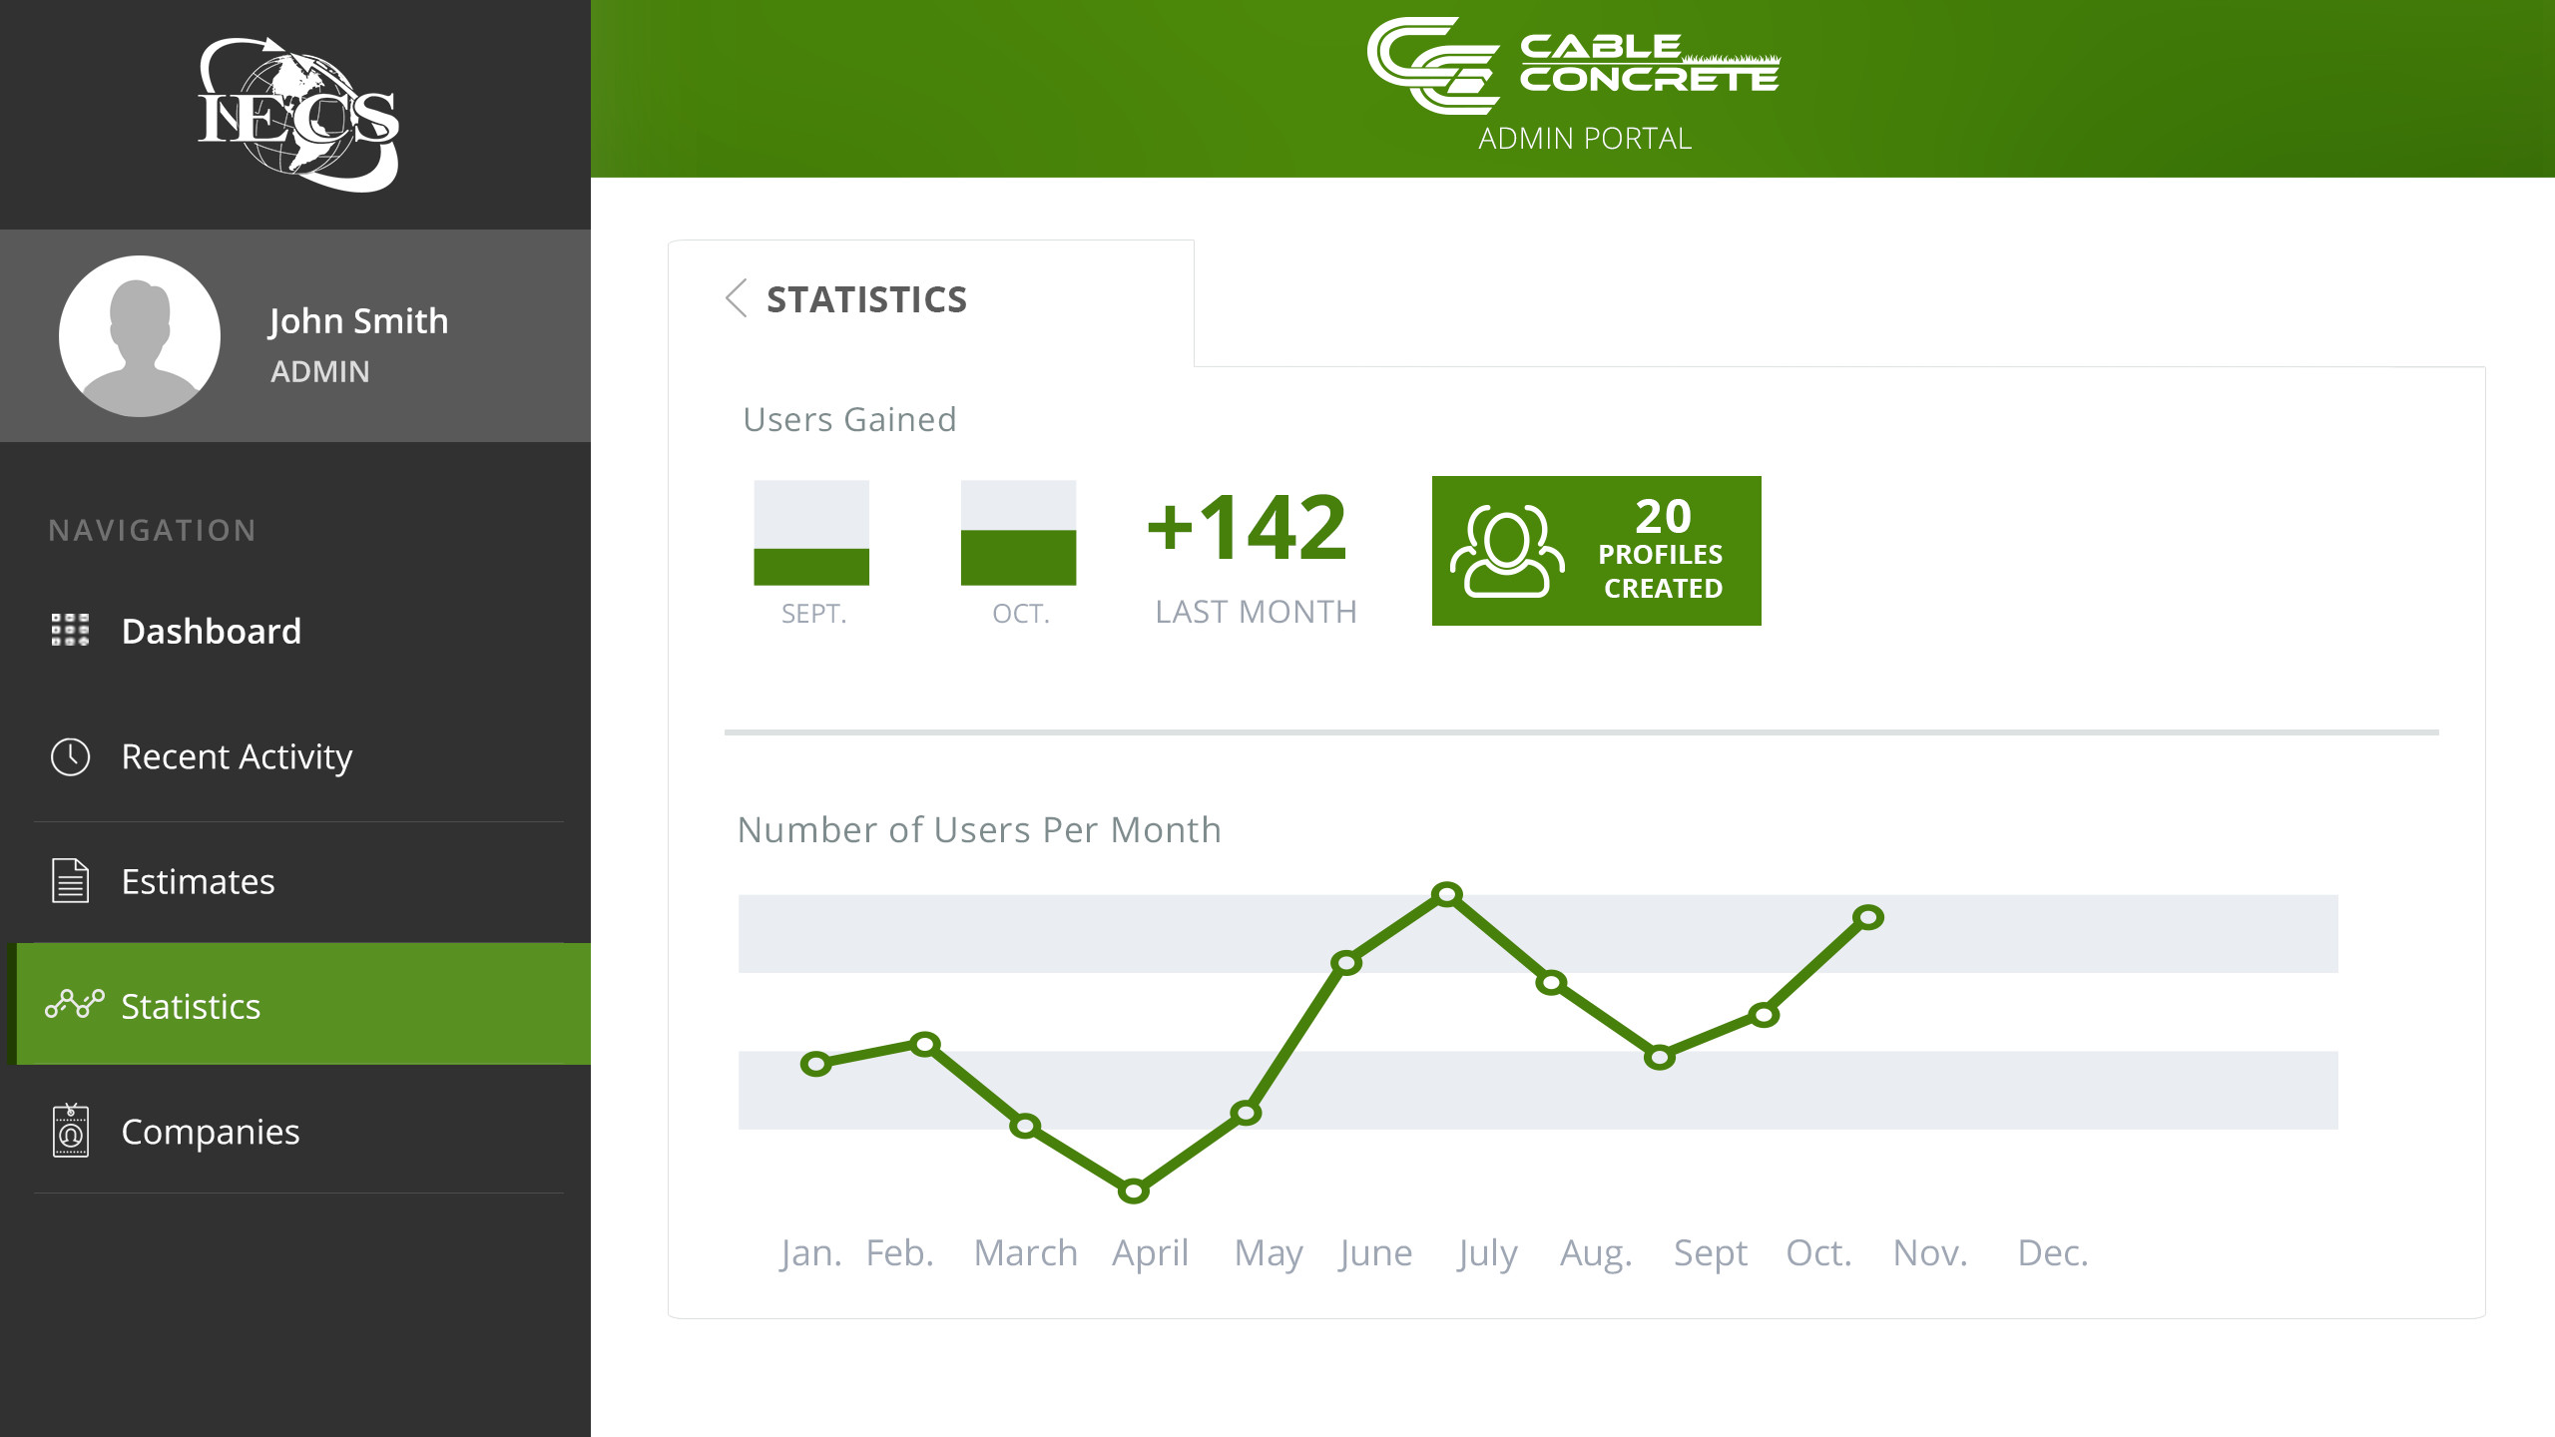
CONTENT MANAGMENT SYSTEM

Slide 33
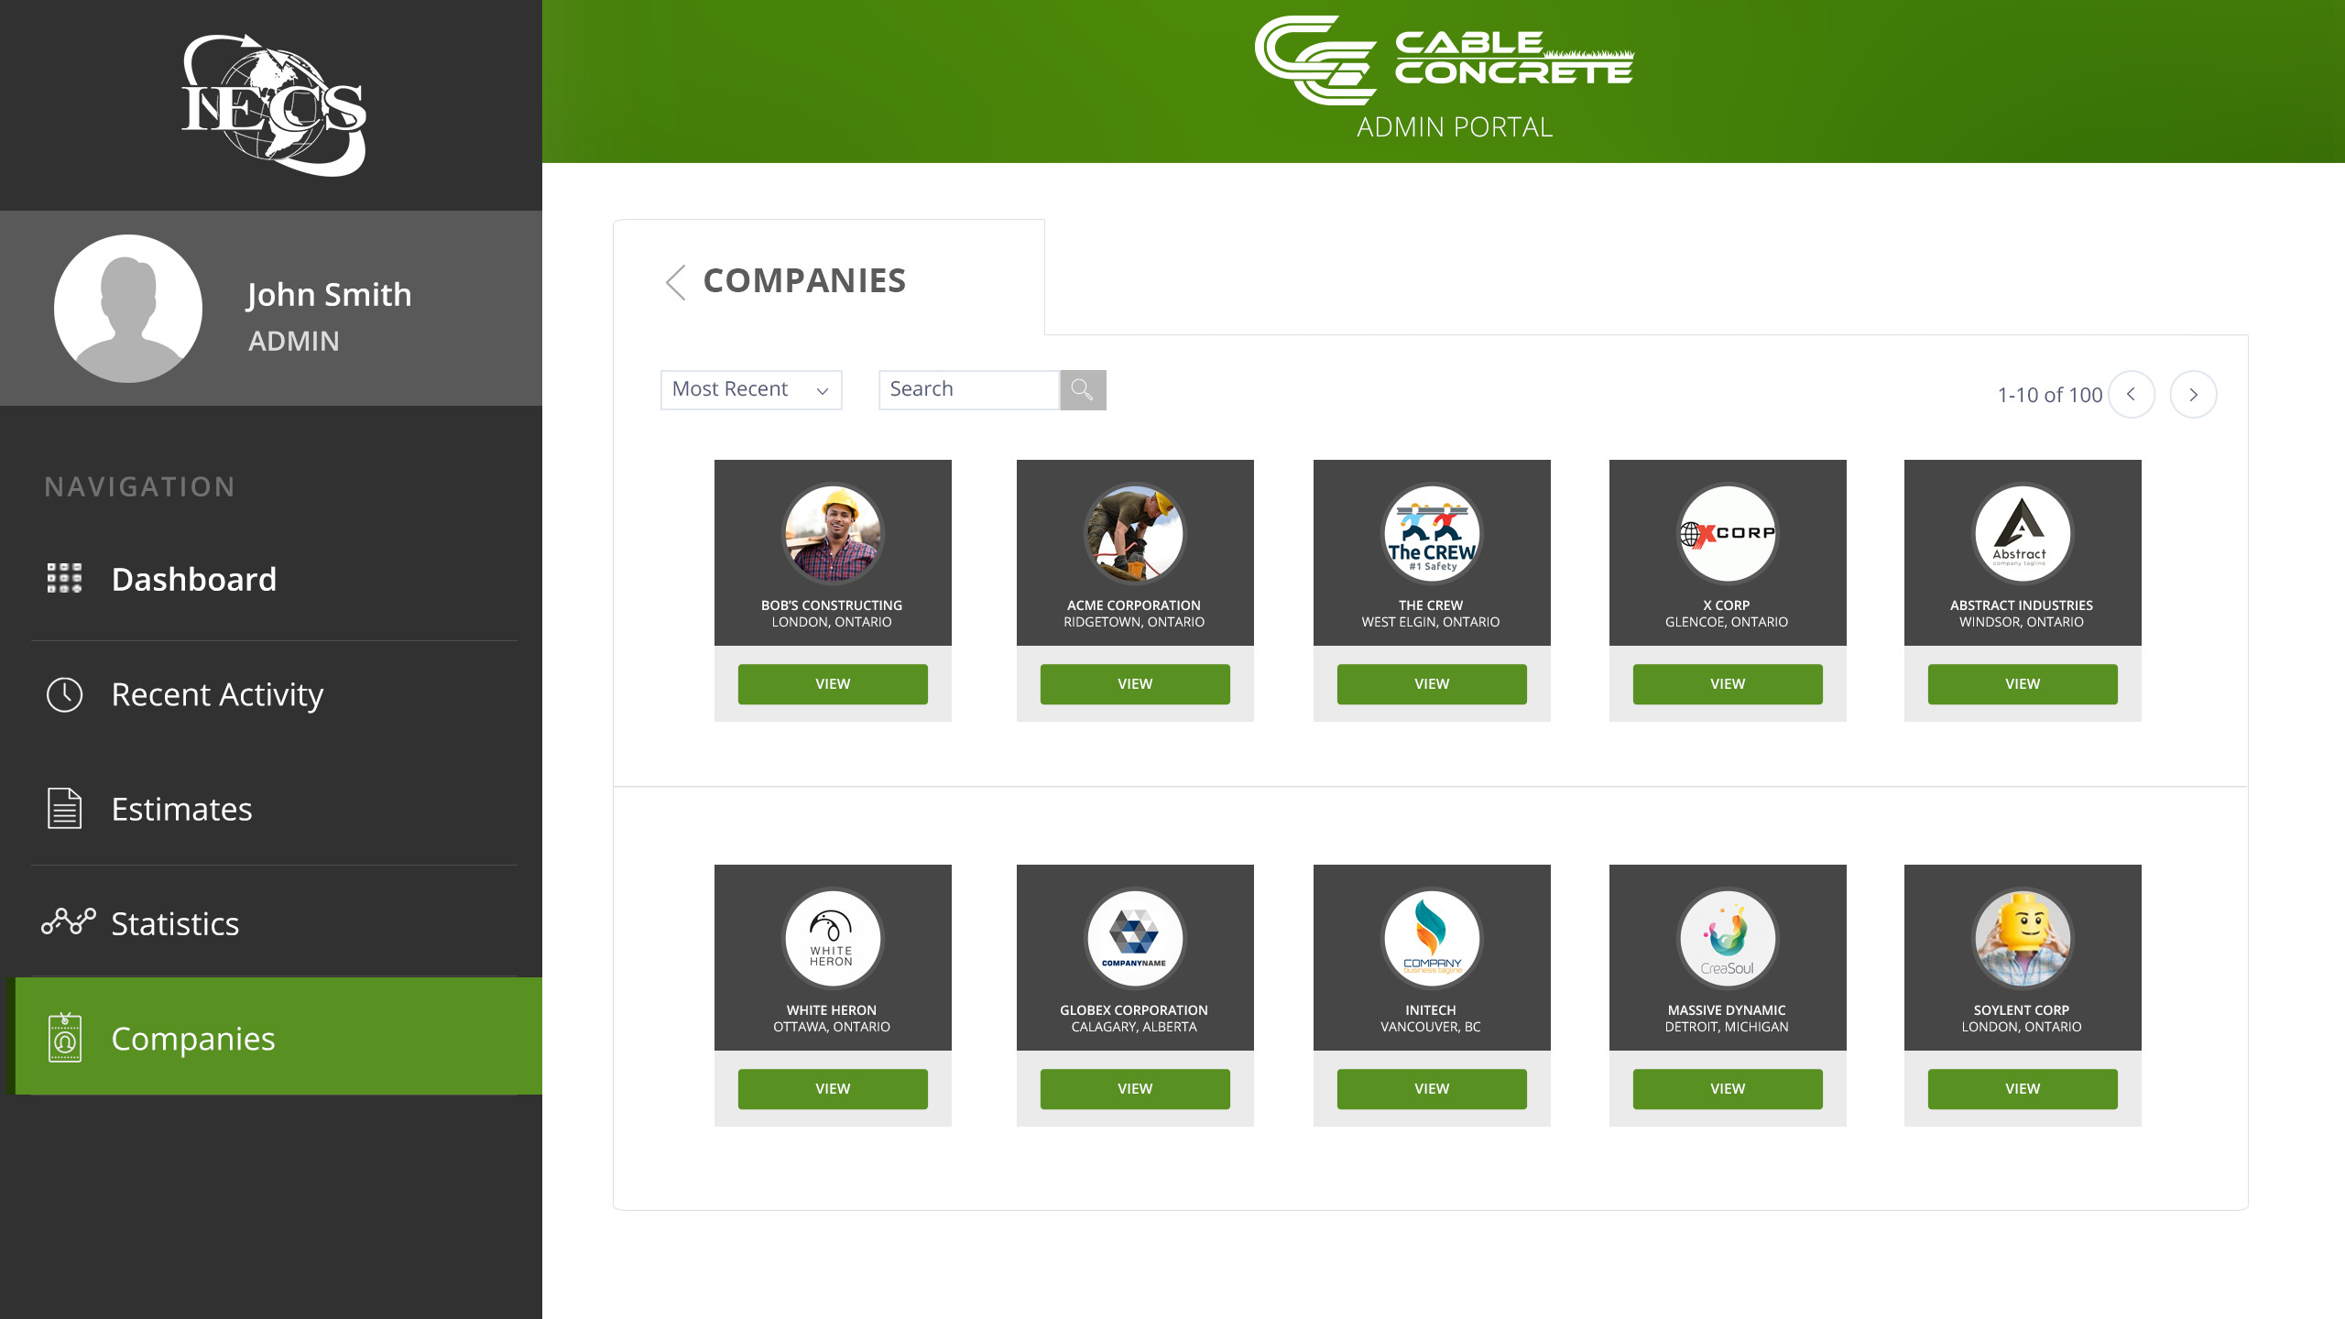
CONTENT MANAGMENT SYSTEM

Slide 34
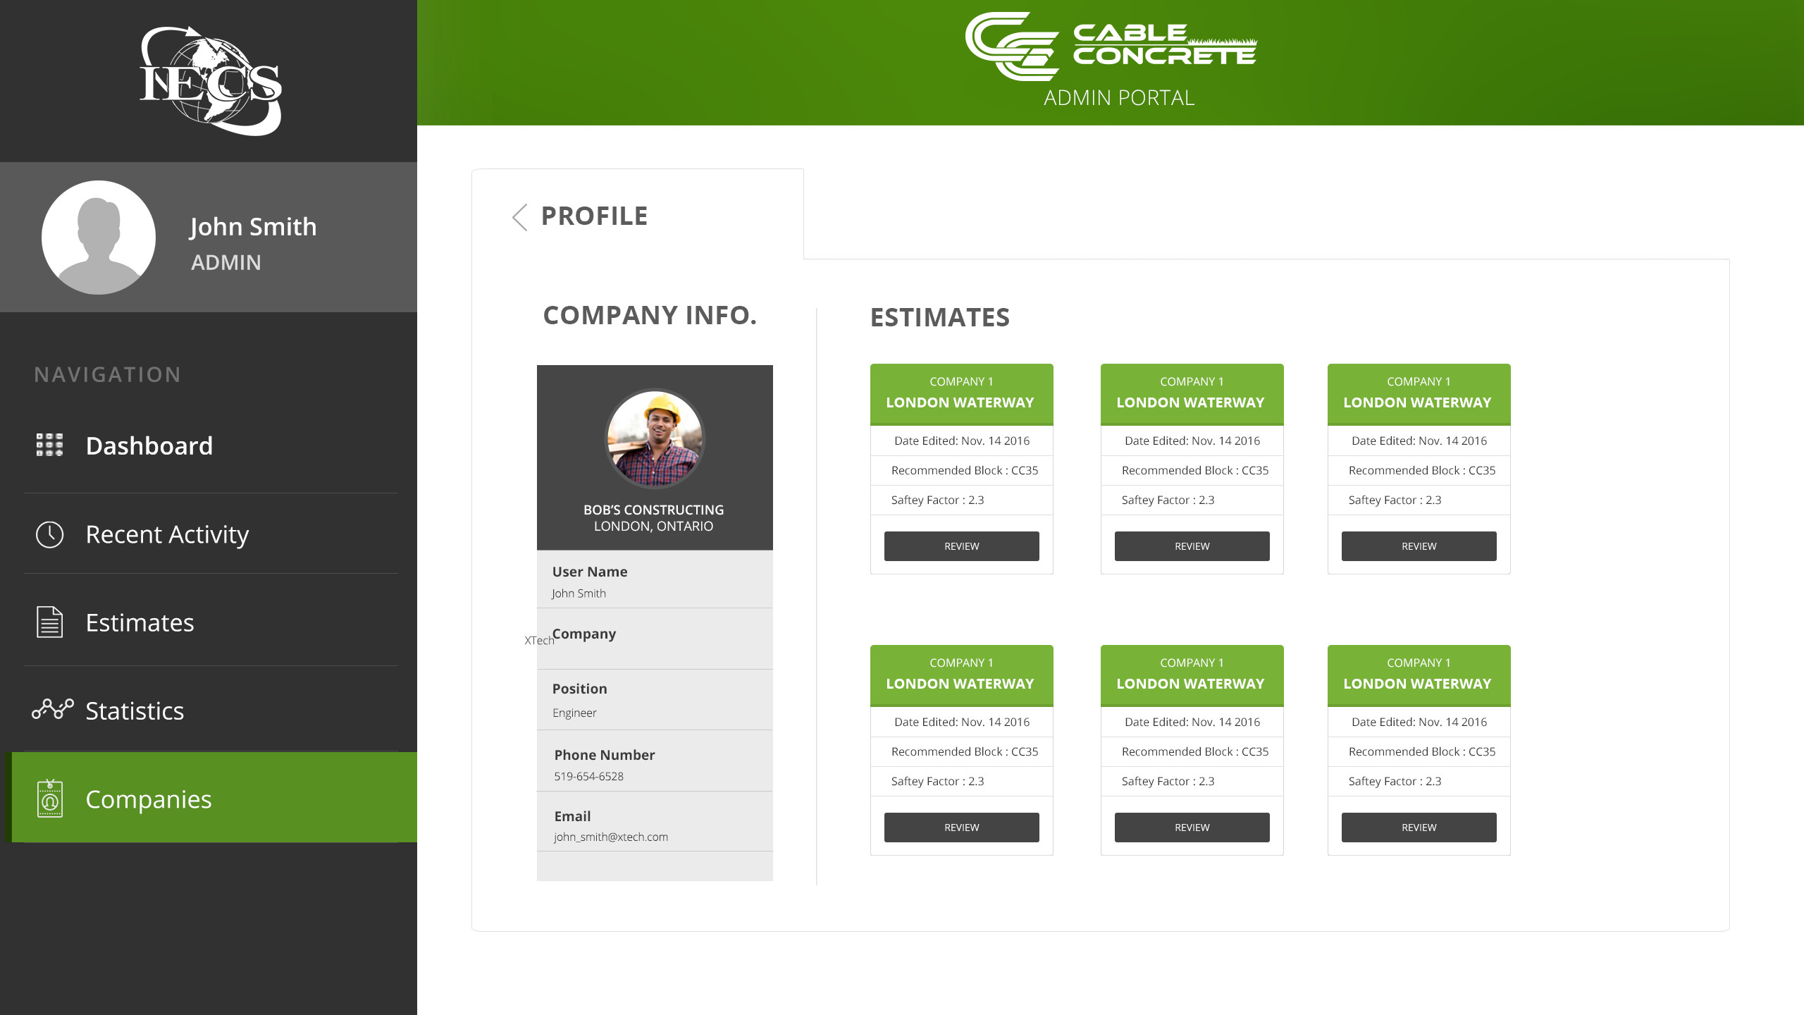
CONTENT MANAGMENT SYSTEM

Slide 35
DECEMBER
Throughout the first week of December, our team will be finalizing designs and implementation to render the app in a usable (but not yet completely flushed-out) state.
JANUARY
After our winter break, work will pick back up again in January with the completion of all elements unfinished from this term, as well as the implementation of any new features that are agreed upon for the web app.
OUR
TIMELINE
FEBRUARY, MARCH, APRIL
This process will continue into February, March and April, with new features being added and discussions about other possible web application tools taking place.

Slide 36

EXPERIENCE WITH CLIENT
Overall, we would say that our experience with the client has been very positive. Not only has Greg been a very engaged and active client, but his accurate feedback has allowed the implementation of the IECS Cable Concrete Calculator to proceed according to schedule. Additionally, working with Greg has provided us, as students, with tools to engage with our own clients, be it for an agency or freelance work.

